Slide 1
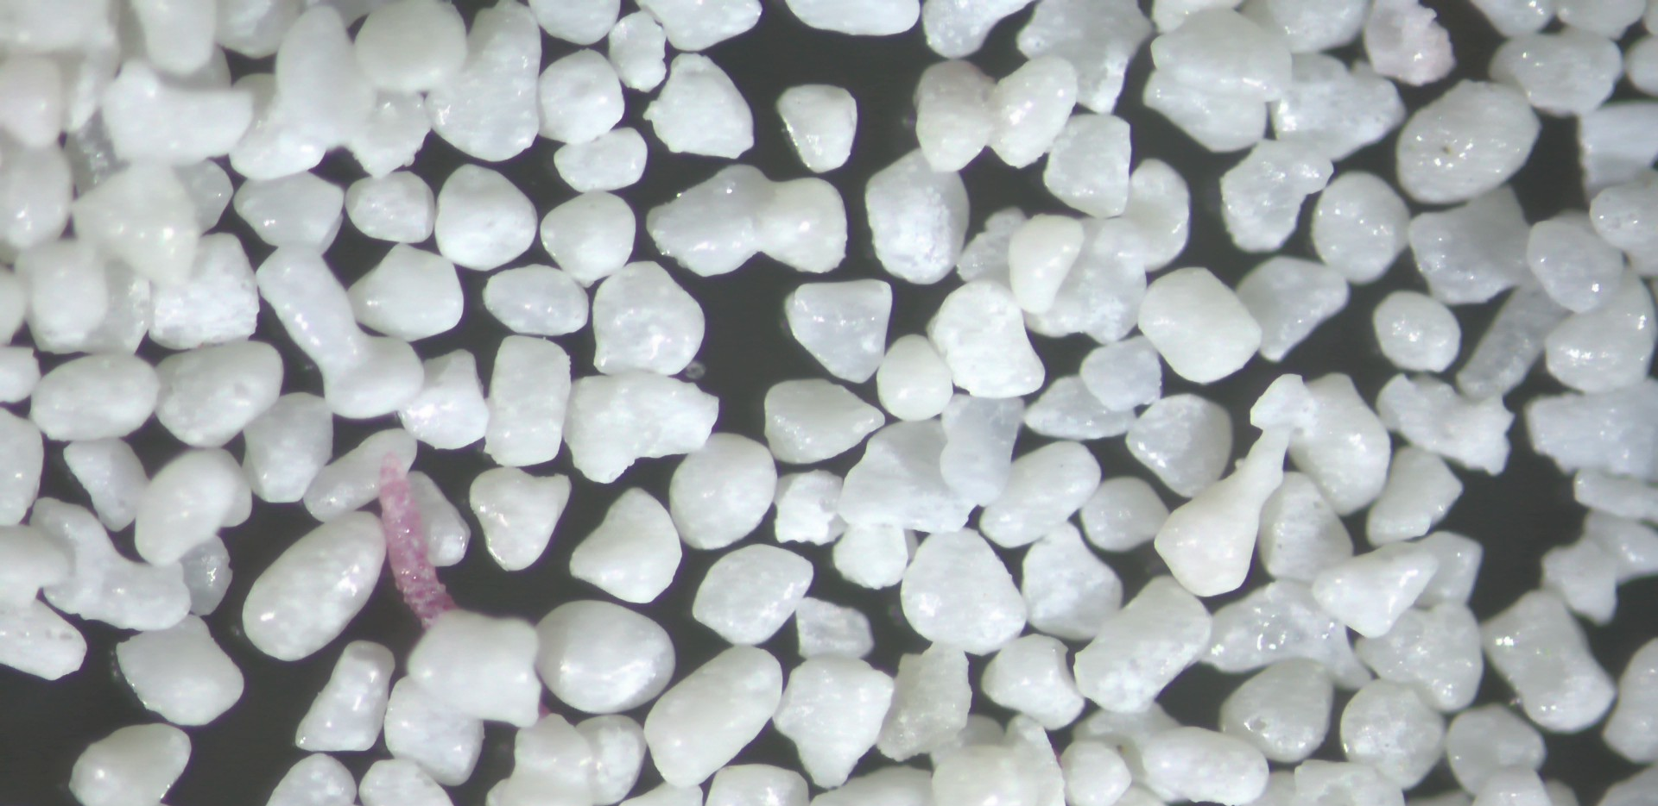

Early marine cementation in skeletal sands and the contrast to diagenesis in non-skeletal grains
Gregor P. Eberli, Mara R. Diaz, G. Michael Grammer
and Ralf J.Weger

Slide 2
Key Points
Eberli et al. 2025
In vitro experiments show that cementation in skeletal sands is slower than in non-skeletal grains, likely due to differences in microbial associations.
Non-skeletal grains, such as peloids and ooids, harbor microbial communities that promote early cementation.
Microbially mediated micritic contact cement are the earliest to form, followed by later stage isopachous and acicular cements.

Slide 3
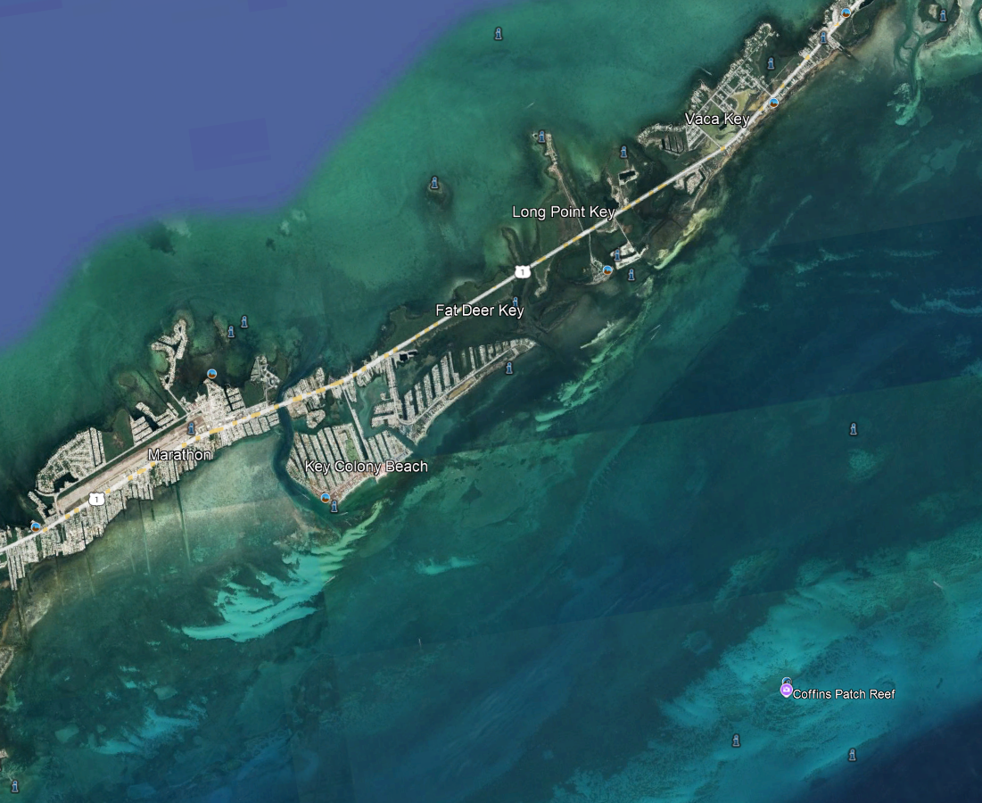
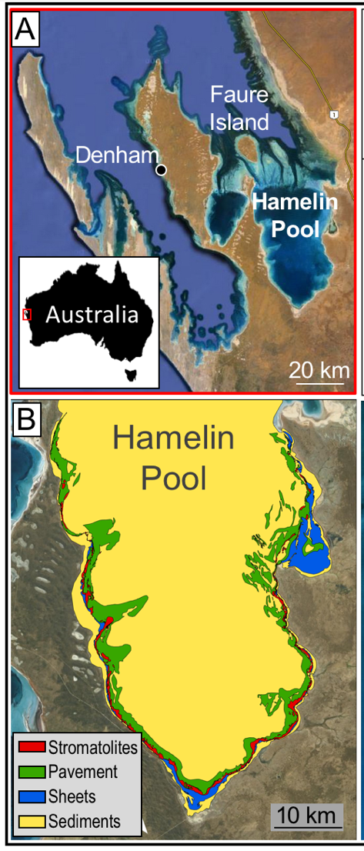
Data sets
Eberli et al. 2025
Florida Keys offshore Marathon Key
Hamelin Pool
GBB and TOTO

Slide 4
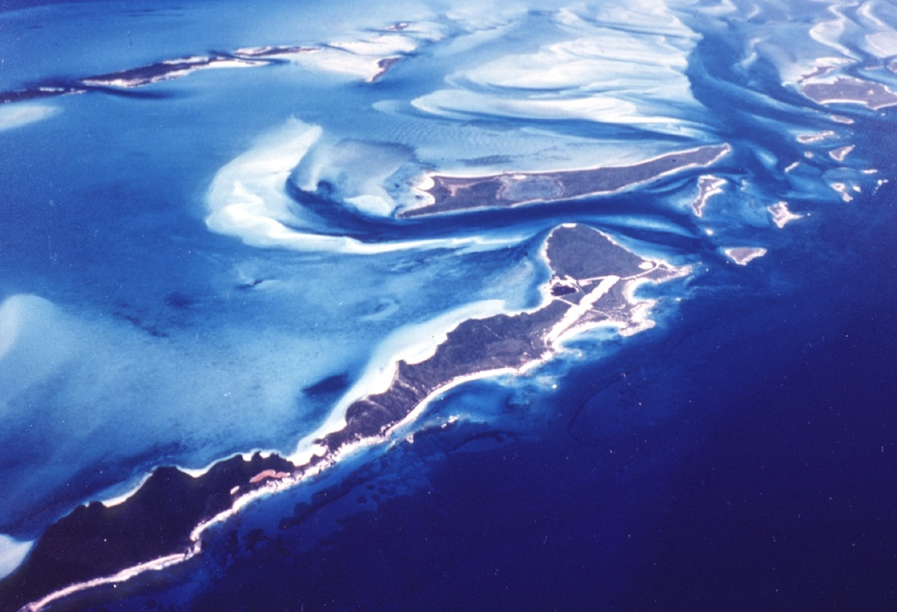
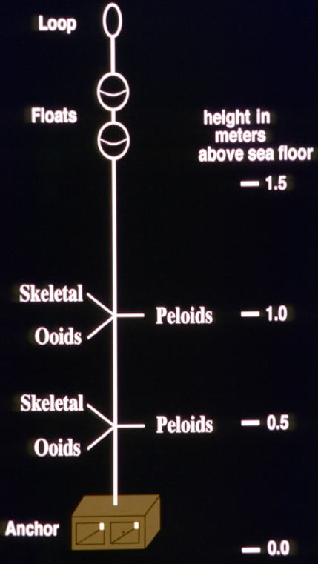
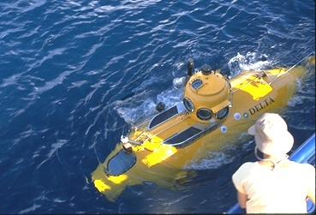
Cementation Experiment TOTO
Eberli et al. 2025
Substrates containing samples of carbonate sands were encased in porous nylon bags (40µm mesh),
Then emplaced at water depths of 30–60 m on the windward side of Lee Stocking
Island in the Bahamas.
And collected after deployment at intervals of 8 and 20 months.
Grammer et al., 1999
AB
Lee Stocking Island
AA
BB

Slide 5
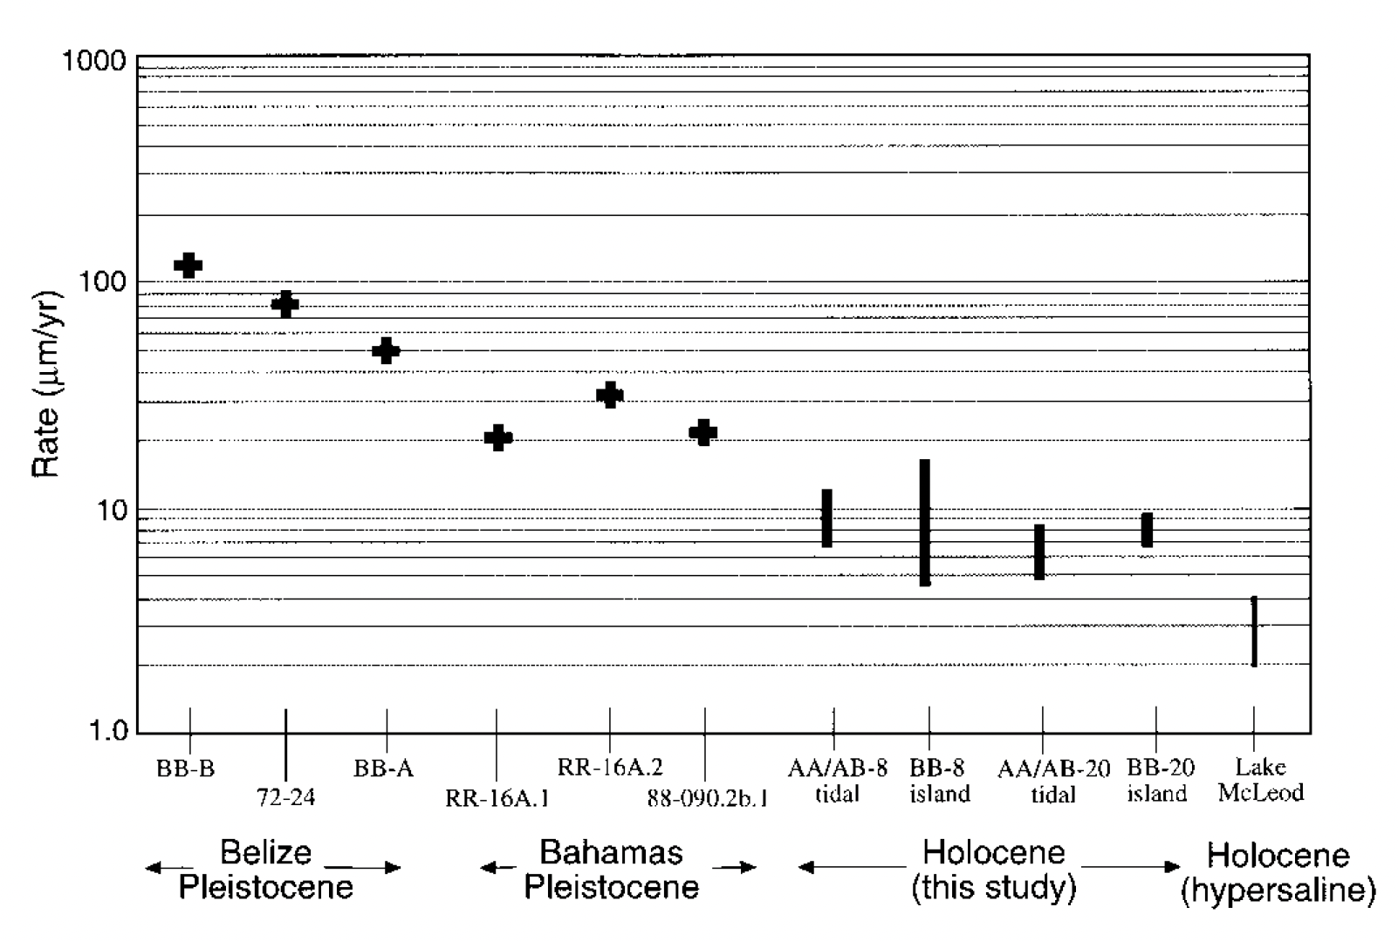
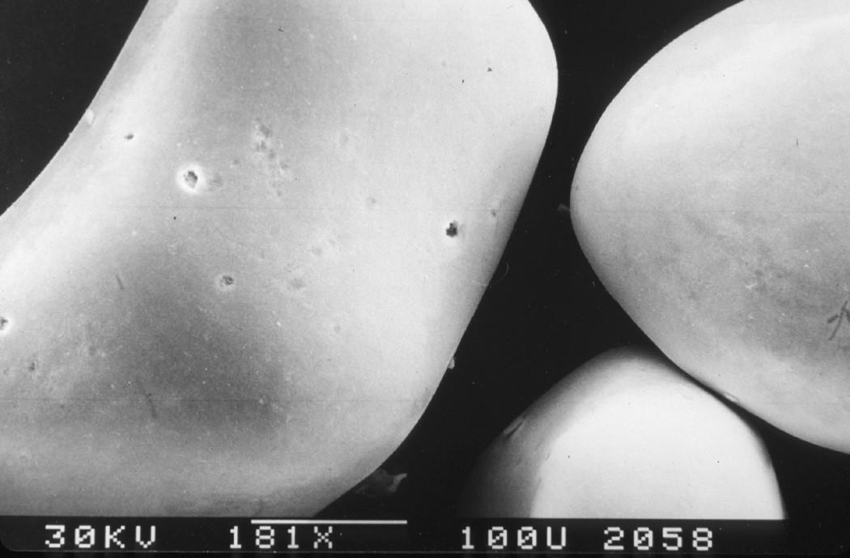
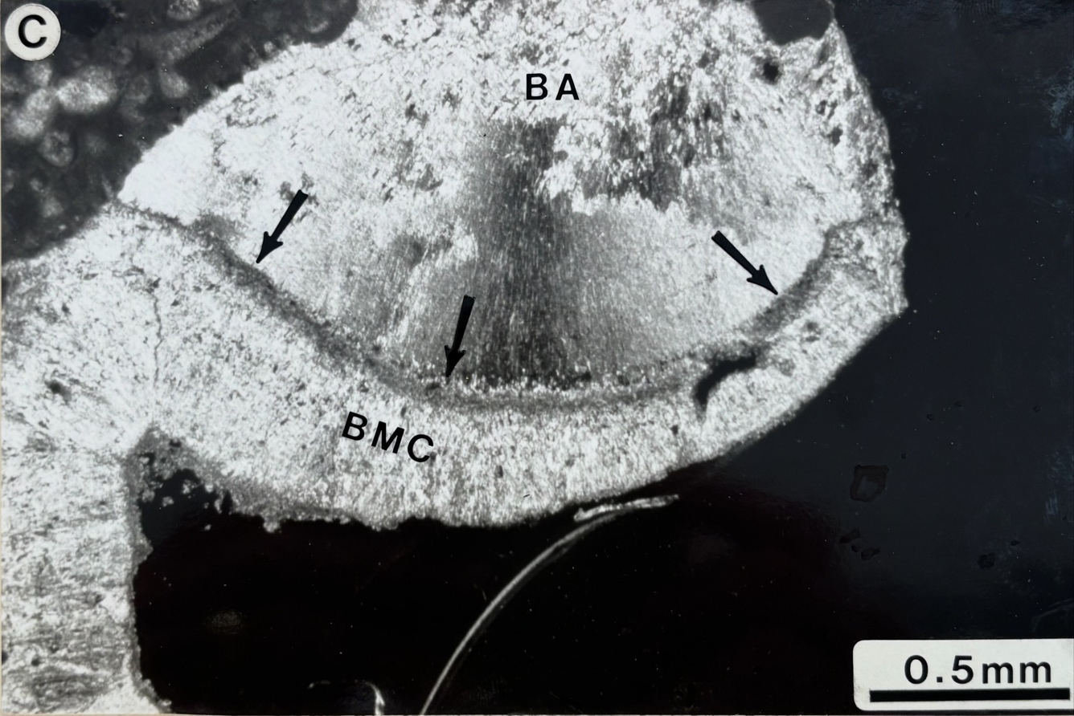
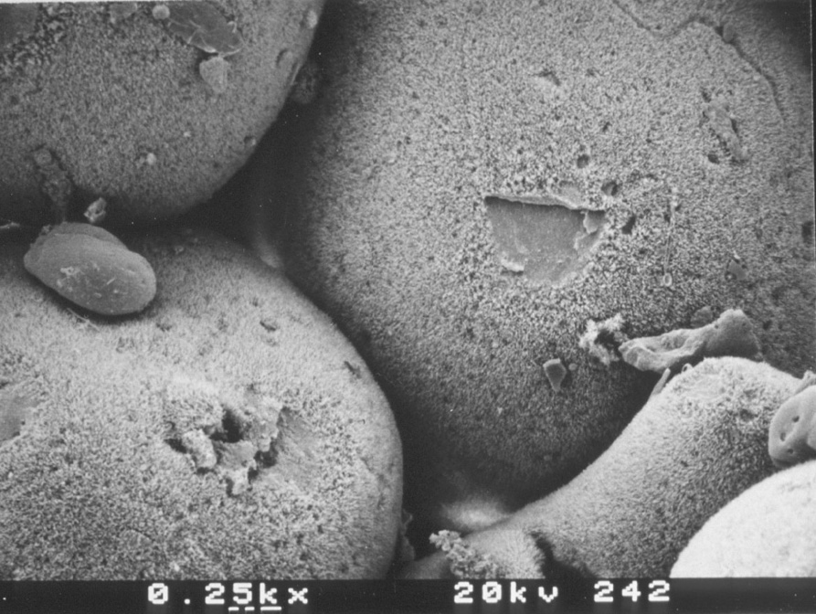
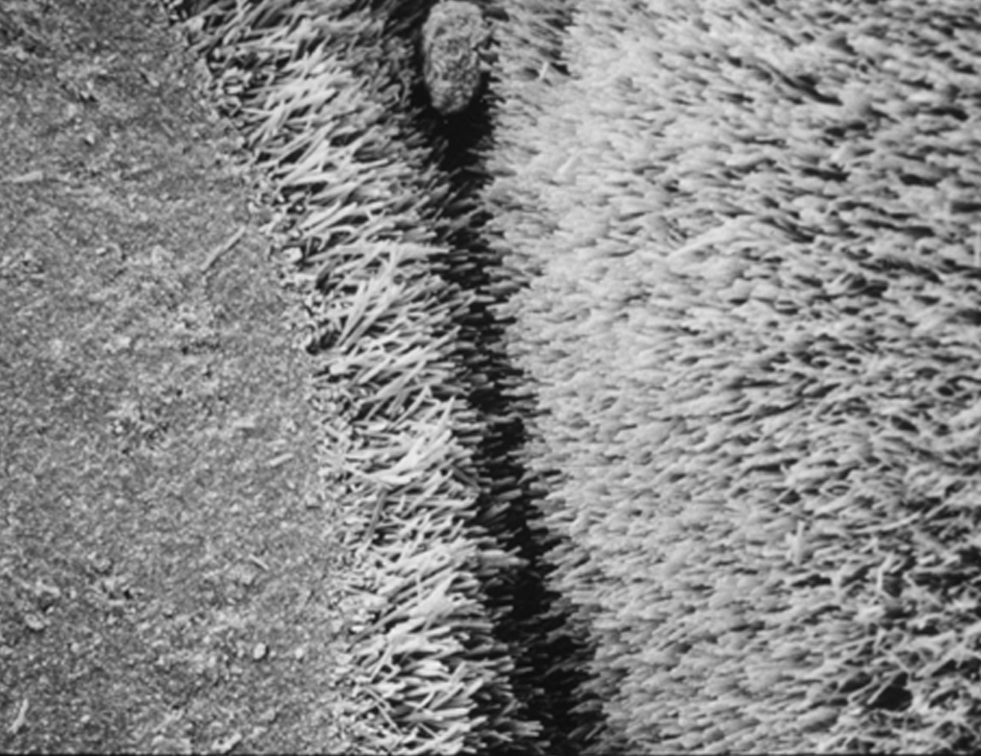
Cementation Experiment ooids
marine cementation rates in deeper platform environments
Eberli et al. 2025
original
8 months
20 months
What about the skeletal sands in the experiment?

Slide 6
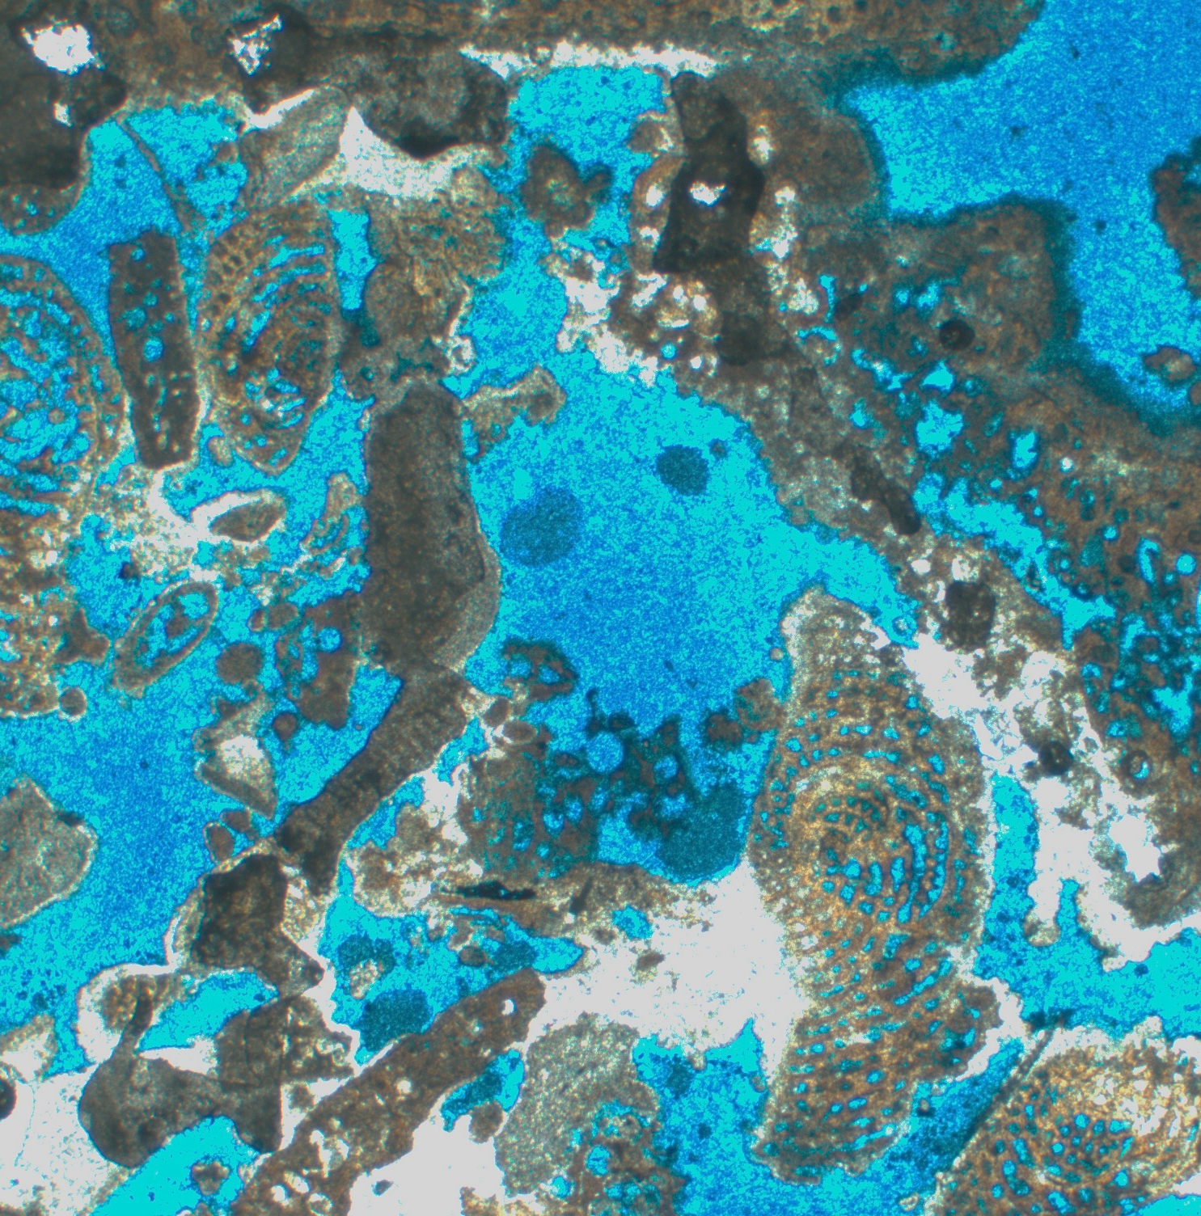
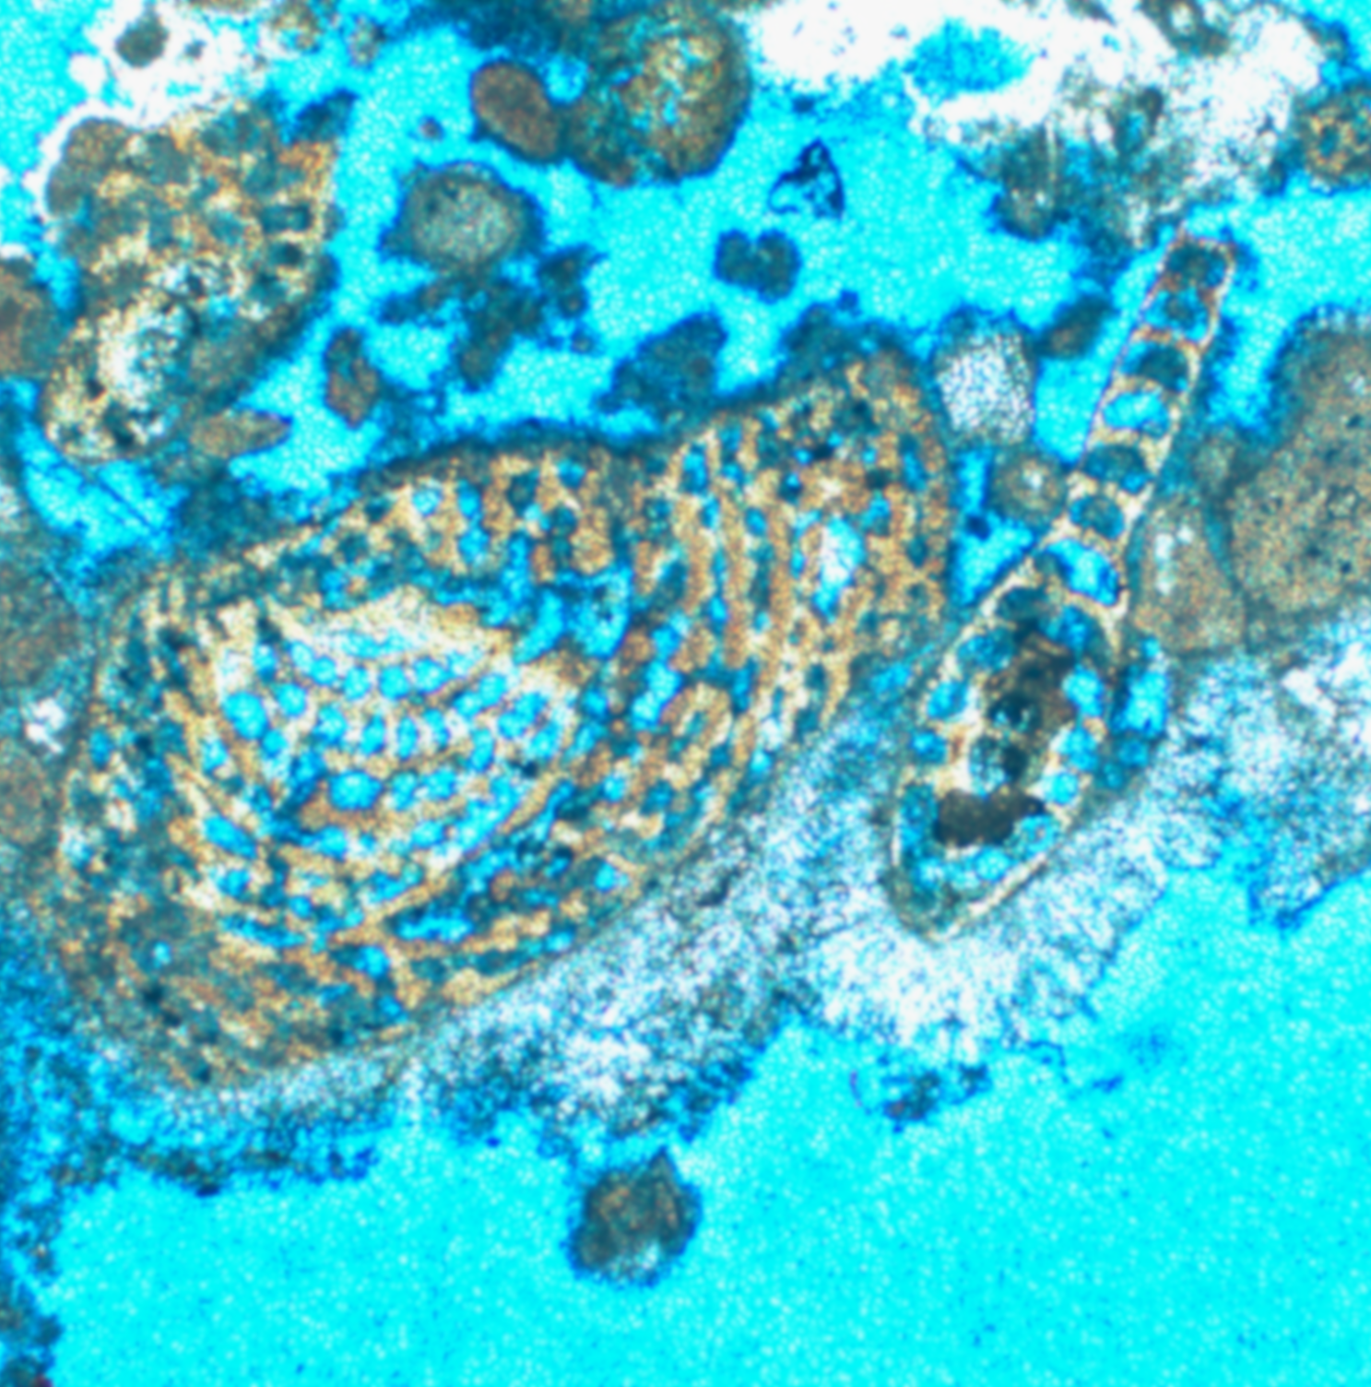
Cementation Experiment skeletal sand
TOTO Grammer Skeletal Sand 20 months
Eberli et al. 2025
500µm
200µm
Skeletal Sand cemented patchy with micrite and acicular cement

Slide 7
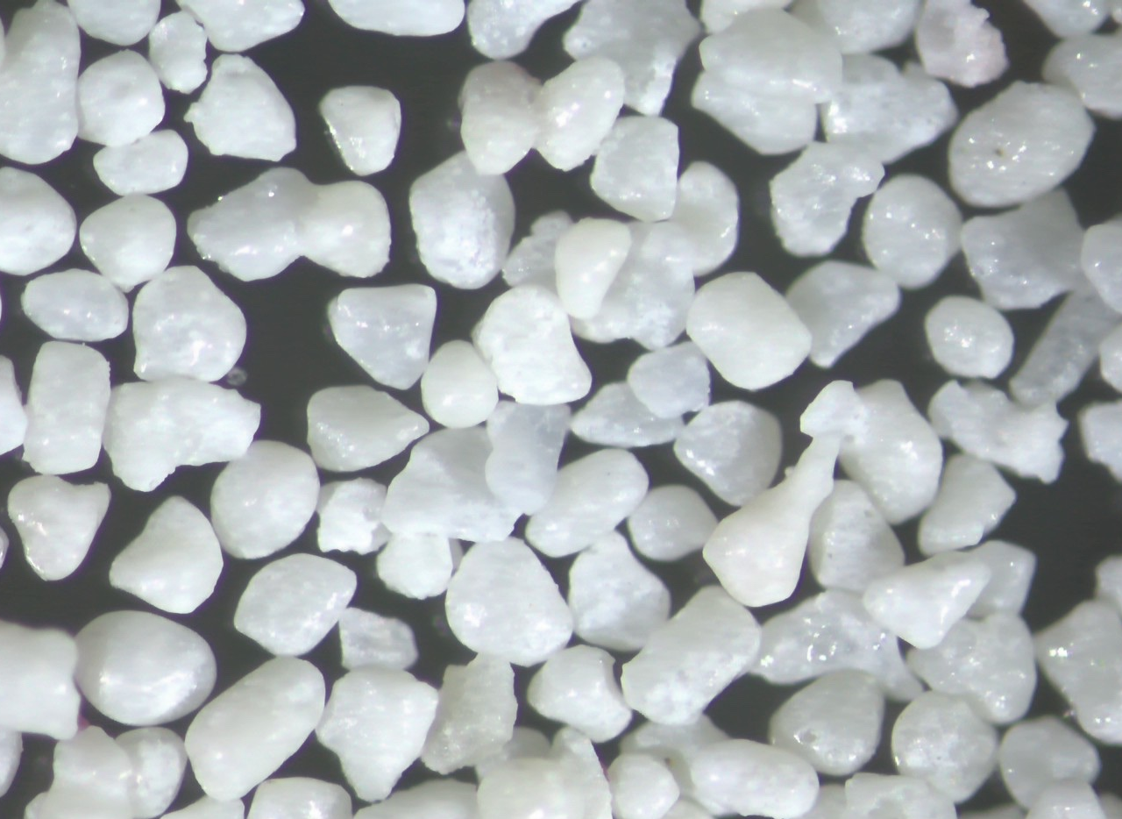
Skeletal Sand – in vitro experiment
Eberli et al. 2025
Florida Reef Tract
Goal:
To assess rate of early marine cementation in skeletal sand and compare it to the rate in ooid sands
To elucidate the effect of microbial communities in diagenetic processes in skeletal grains.
Approach:
in vitro incubation experiments will be conducted with skeletal grains in the presence and absence of microbial marine communities.
1mm

Slide 8
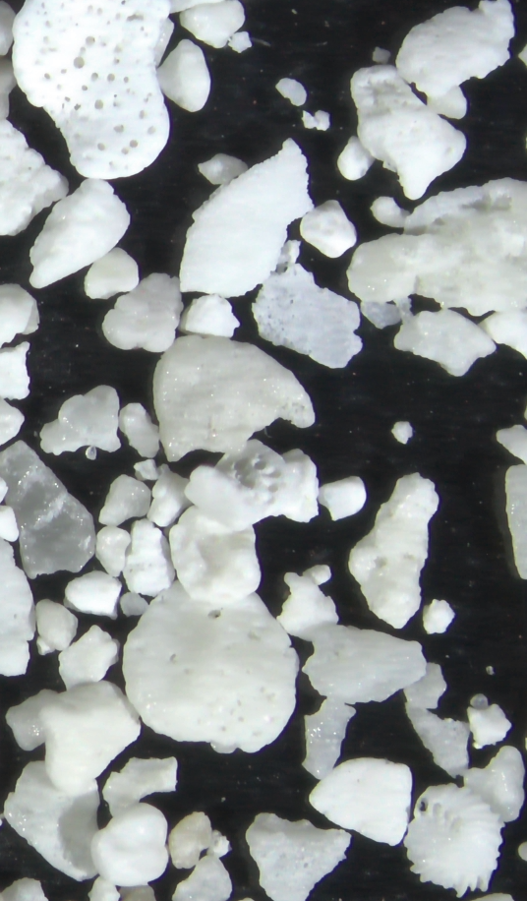
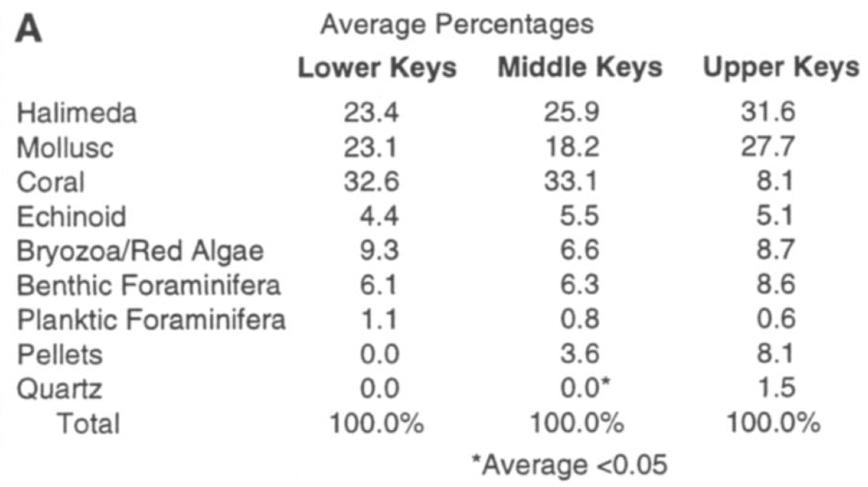
Location and sediment composition
Eberli et al. 2025
Station 61 Middle Key
Halimeda | 42.8
Mollusc | 30.4
Coral | 6.2
Echinoid | 8.2
Red Algae | 1.6
Benthic Forams | 10.1
Planktonic Forams | 0.7
Pellets | 0
LIDZ, B.H. and HALLOCK, P., 2000. Sedimentary petrology of a declining reef ecosystem, Florida Journal of Coastal Research, 16(3), 675-697. West Palm Beach

Slide 9
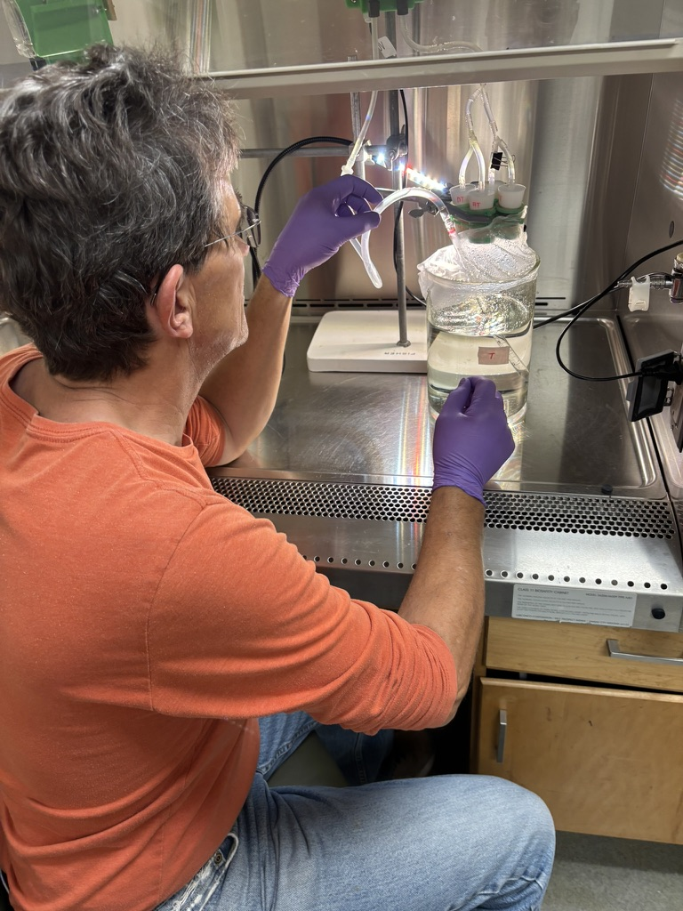

Experimental set-up
Incubation set-up:
Flow system with filtered sea water containing no additional microbes
12 hours interval with fluorescent light to allow photosynthesis and 12 hours darkness to stimulate heterotrophic activity under low oxygen conditions
Incubation duration:
Skeletal sand were analyzed at 0, 30, 60, 90 and 120 days.
Seawater composition:
0.9 μM NO₃, 0.3 μM NH4 and 0.03 μM PO₄, while dissolved inorganic carbon (DIC) 2076 (μmol/kg)
and total alkalinity average and 2432 (μmol/kg)

Slide 10
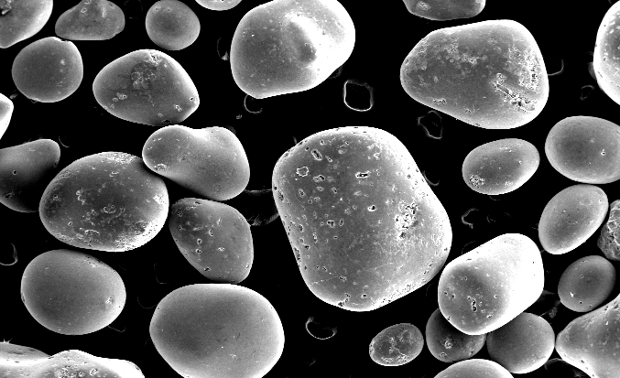
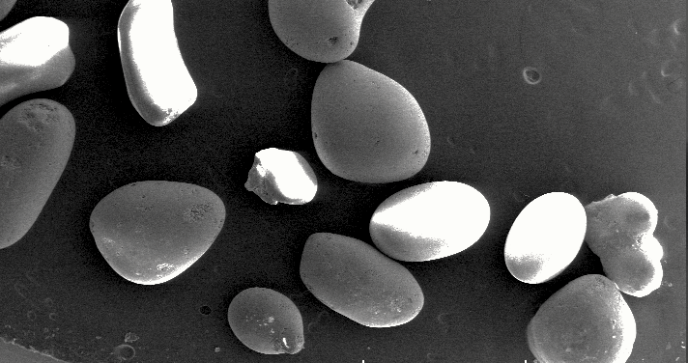
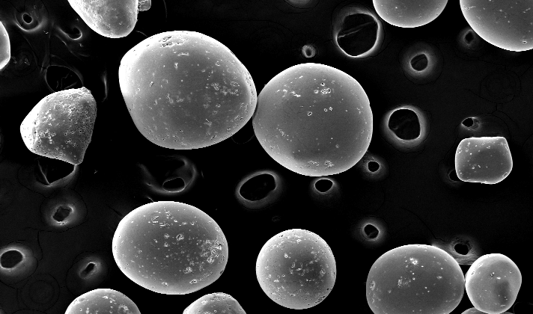
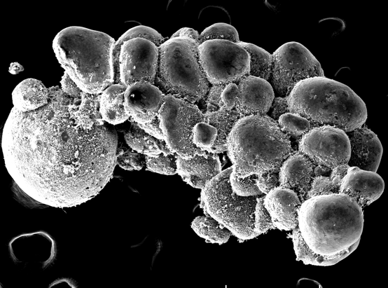
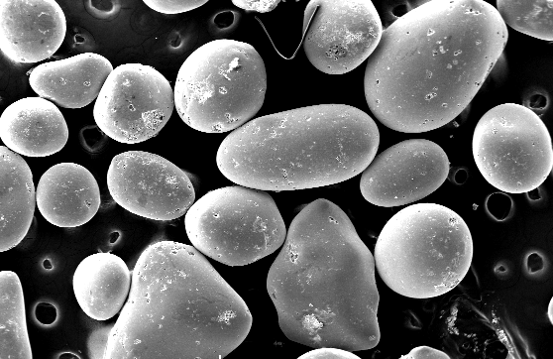
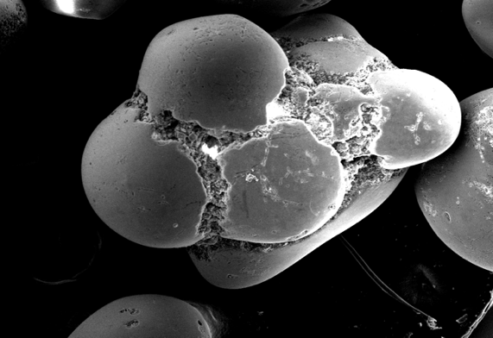
Experimental formation of grapestones
Eberli et al. 2025
Sterile Ooids
Ooids with microbes
Time 0
1mm
1 mm
30 days
500 µm
500 µm
500 µm
60 days
Filtered sea water with
no additional microbes or nutrients
Incubation time 0, 30, 60 days

Slide 11
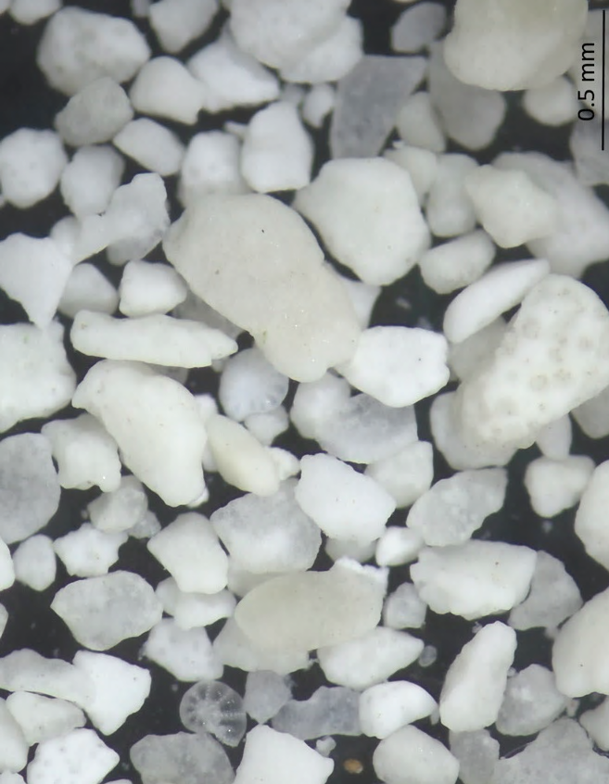
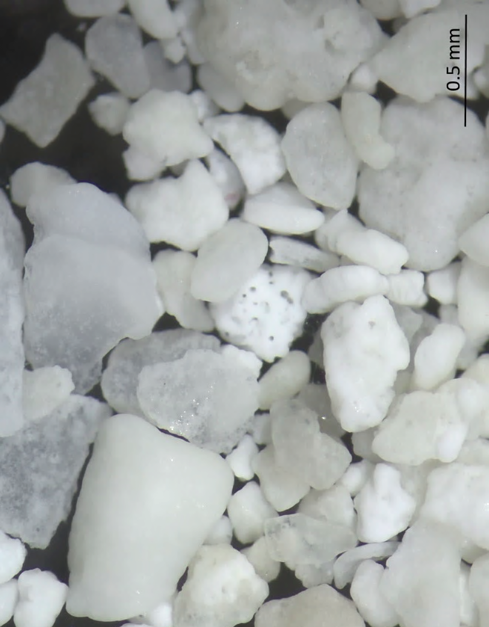
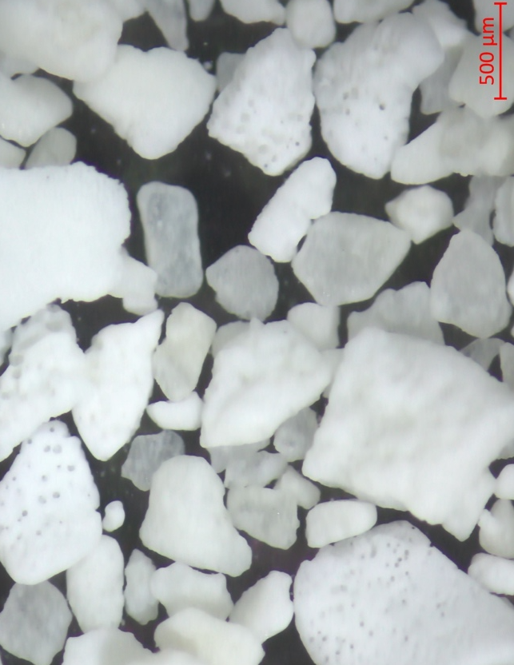
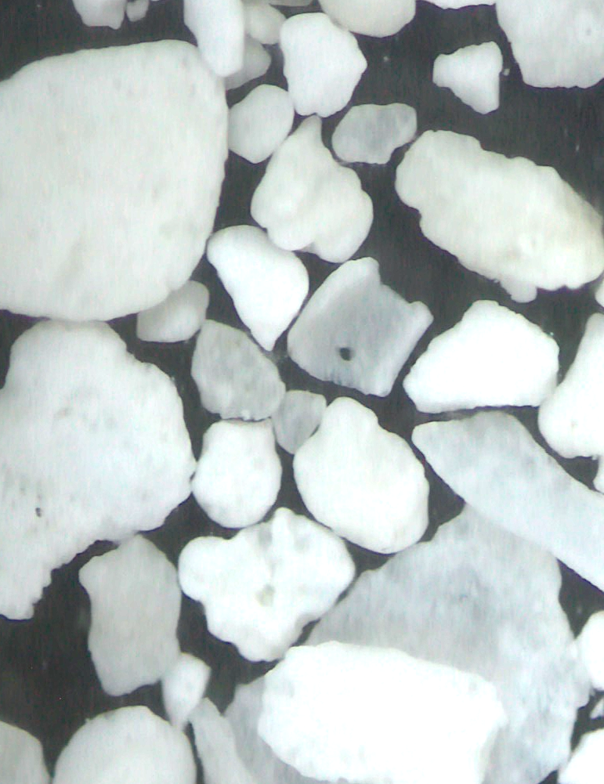
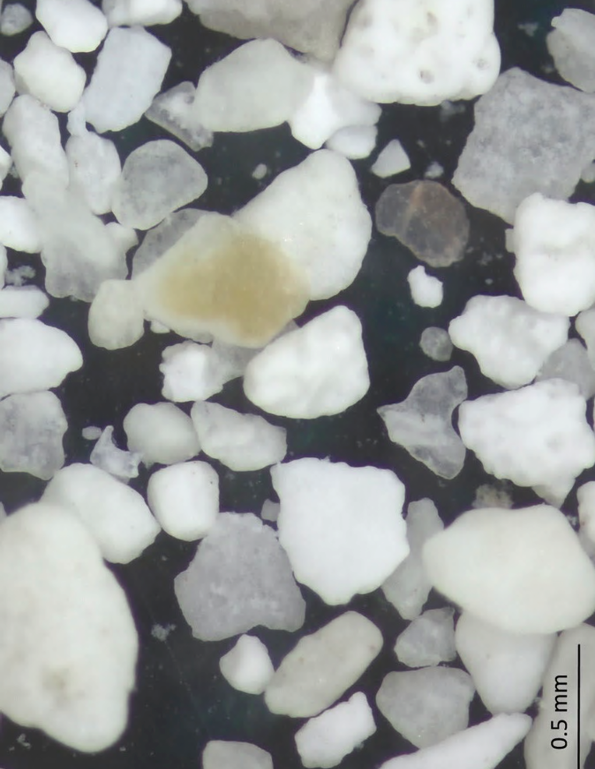
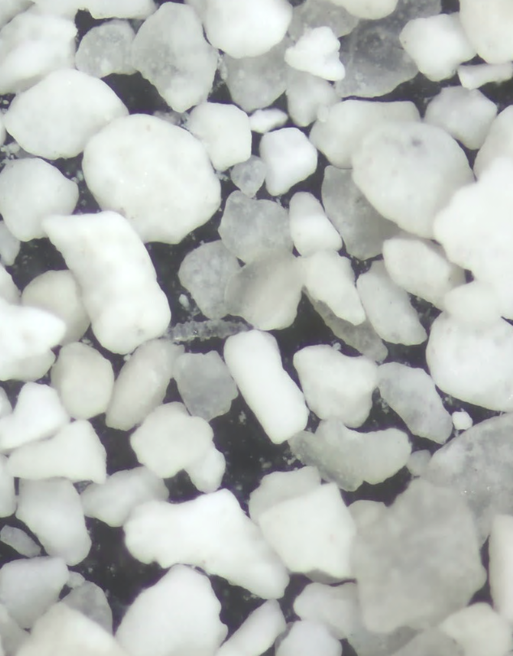
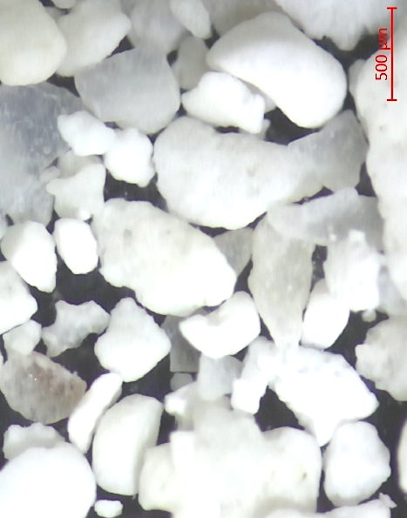
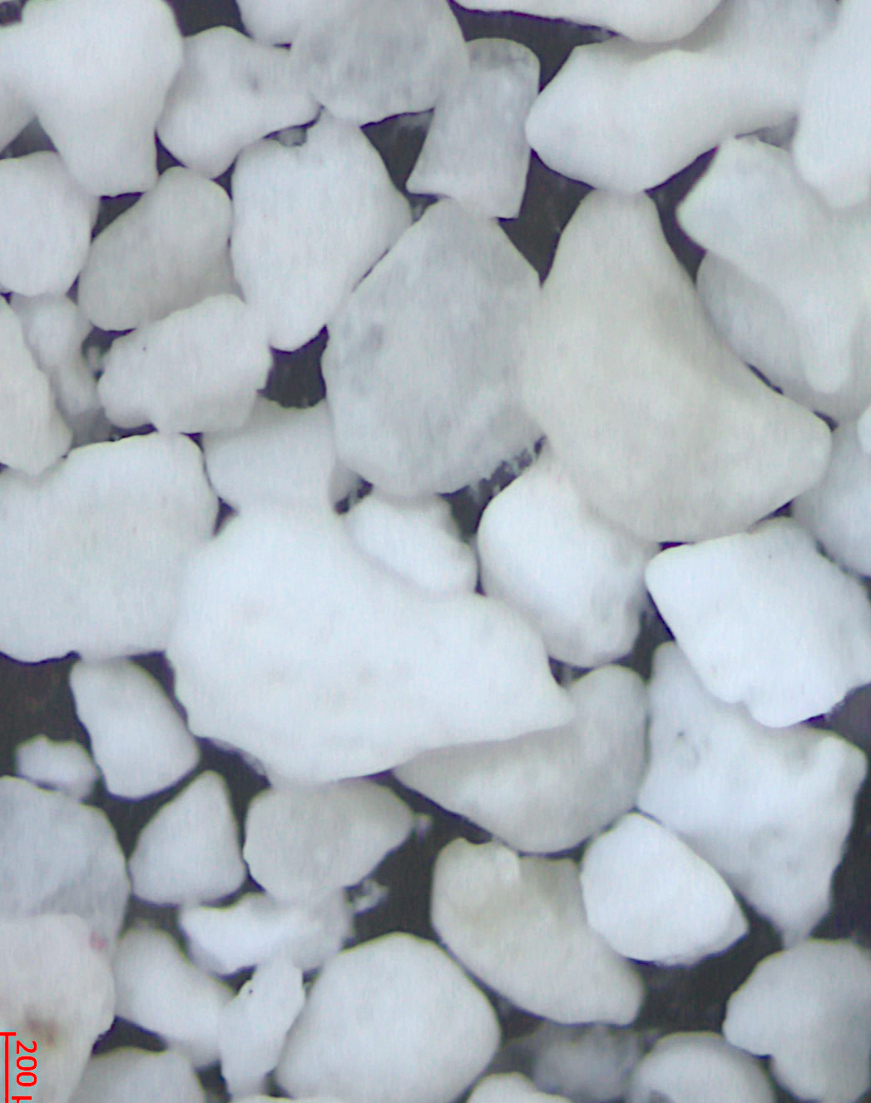
Time 0
30 days
60 days
90 days
Florida Reef Tract
Sterile Skeletal Sand
Sterile Skeletal Sand
1mm
1 mm
500 µm
500 µm
Sand with microbes
Sand with microbes

Slide 12
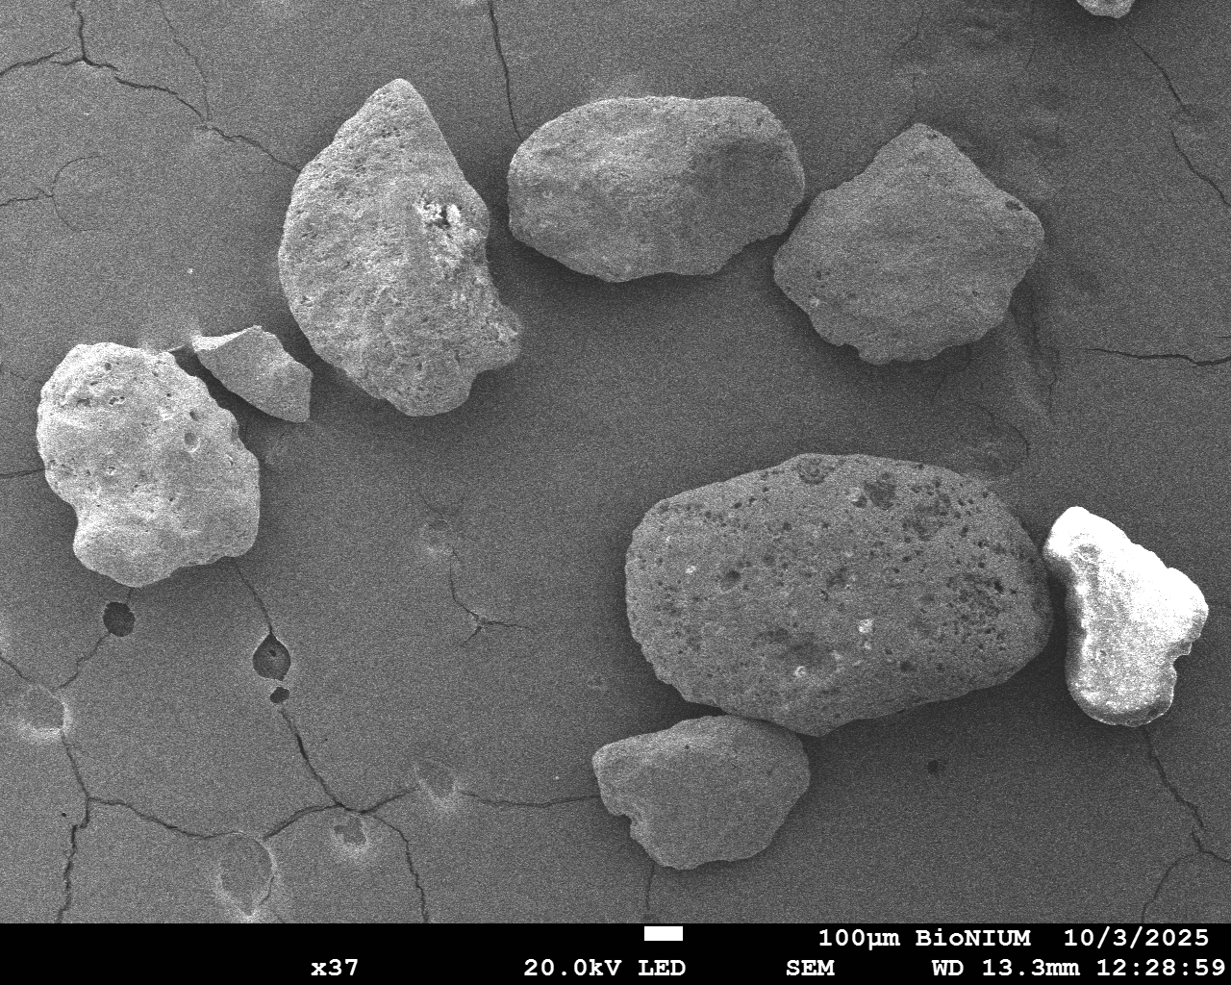
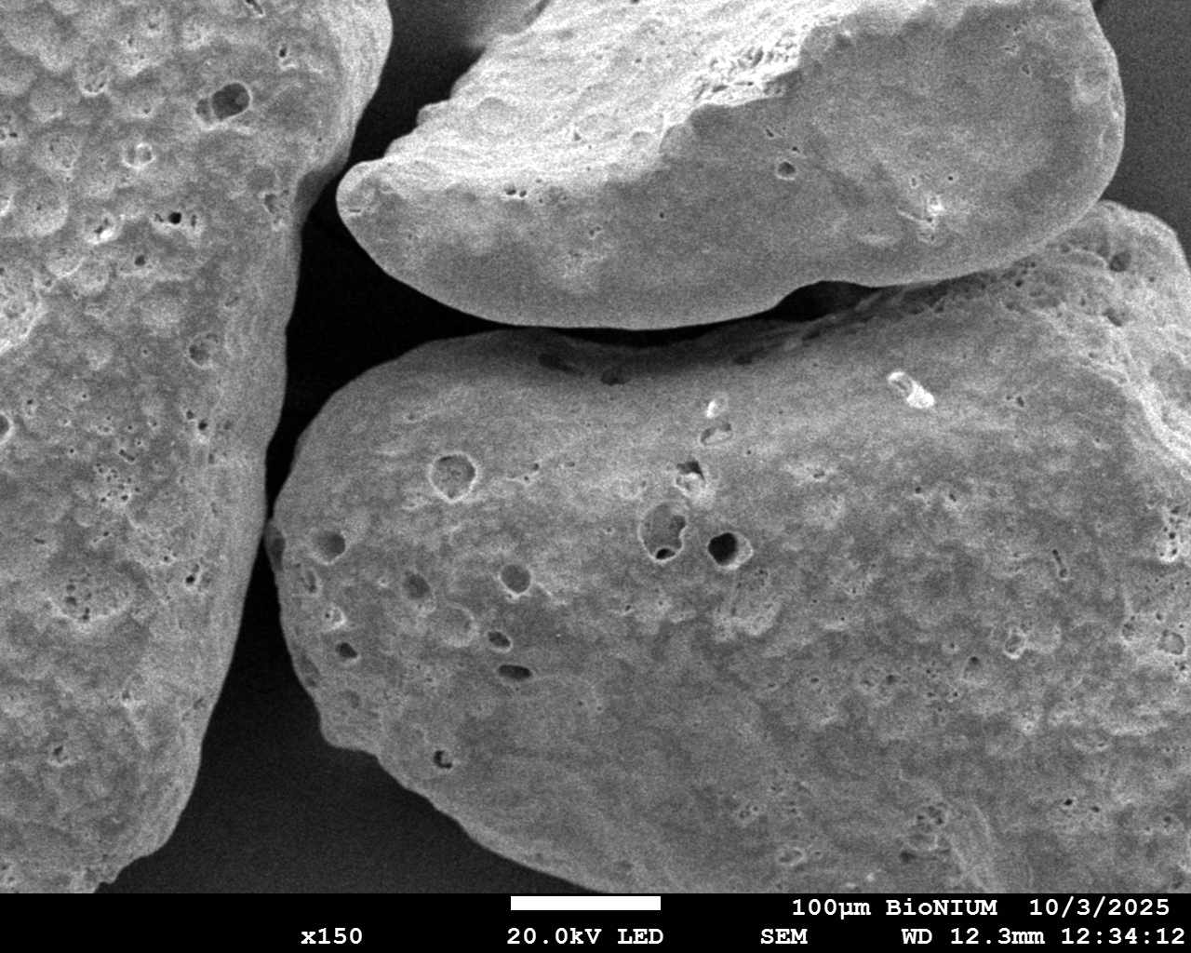
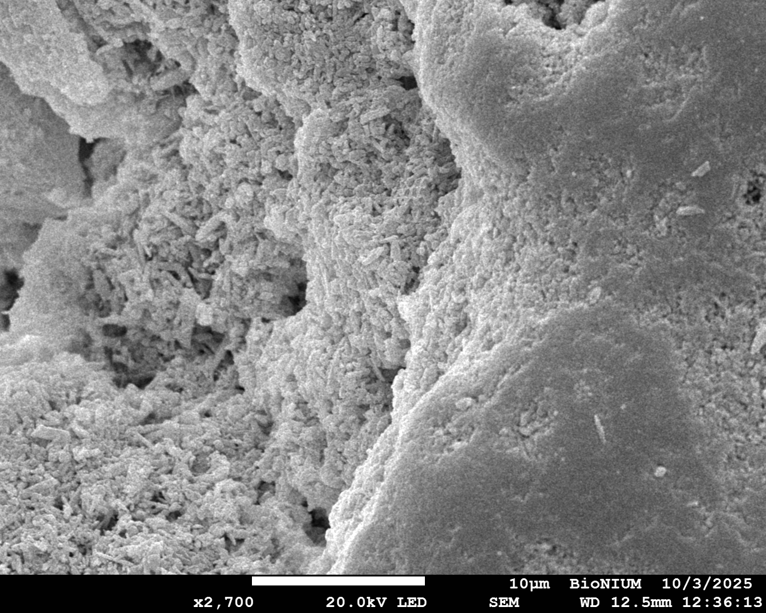
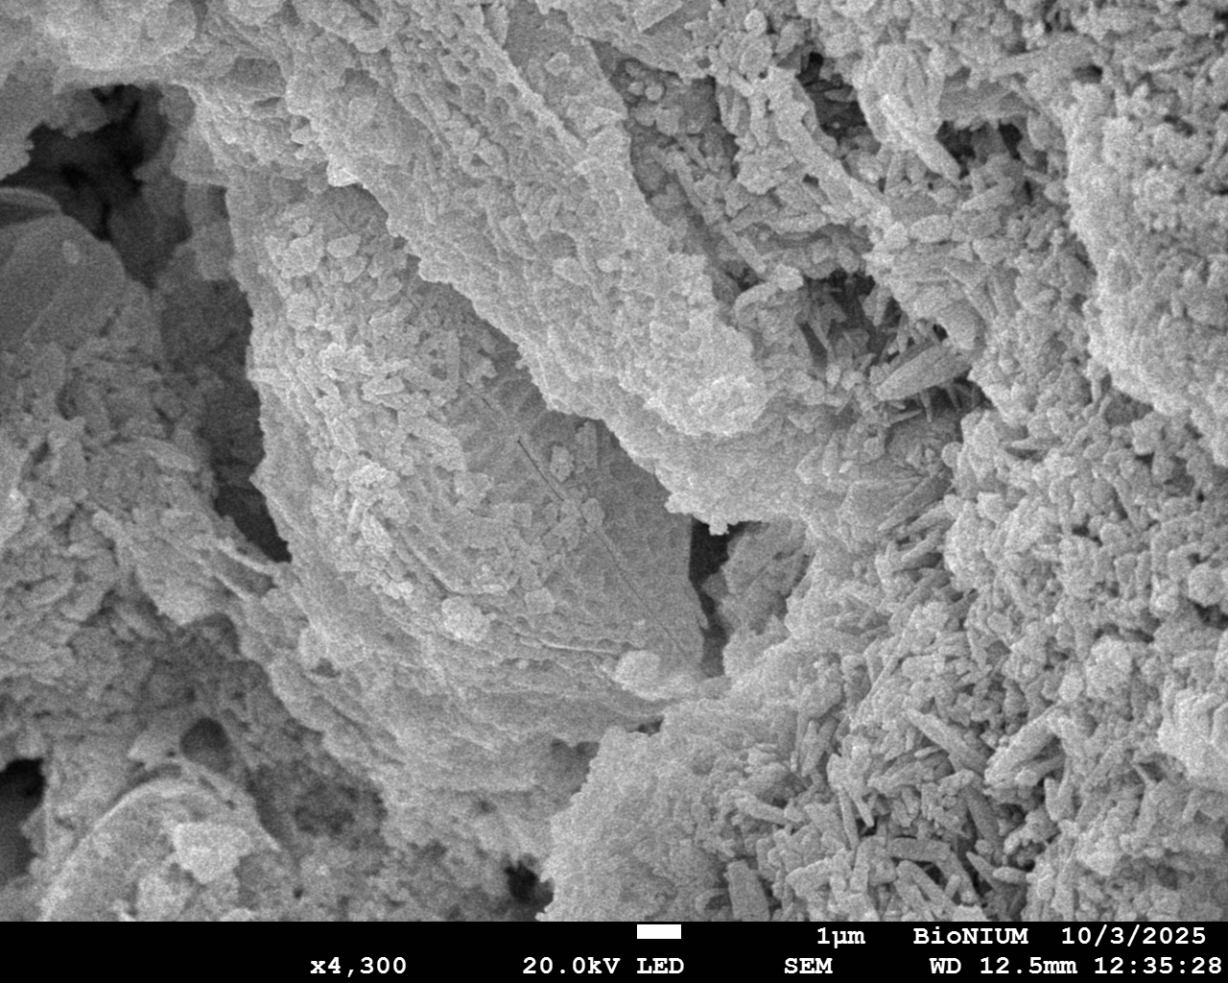
Time 0 treated – no microbes
Eberli et al. 2025
Notes:
Time 0
Treated

Slide 13
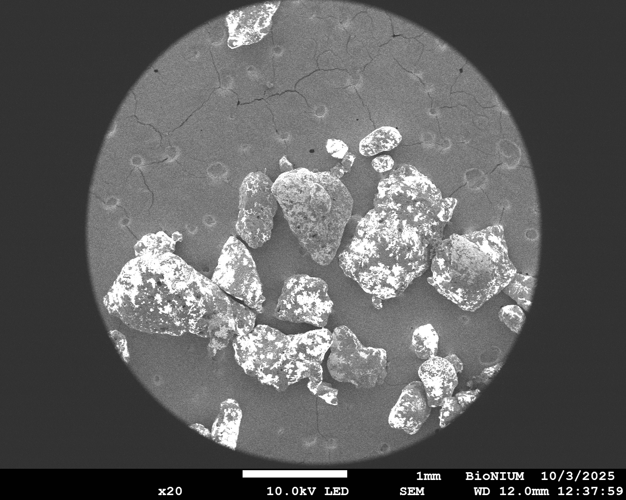
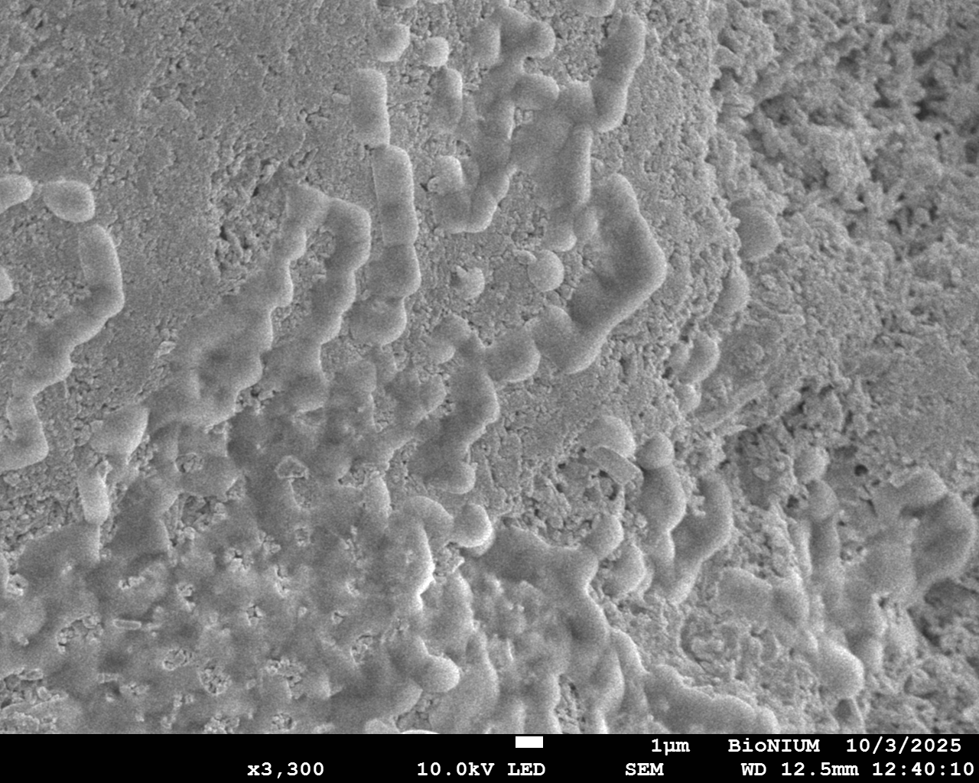
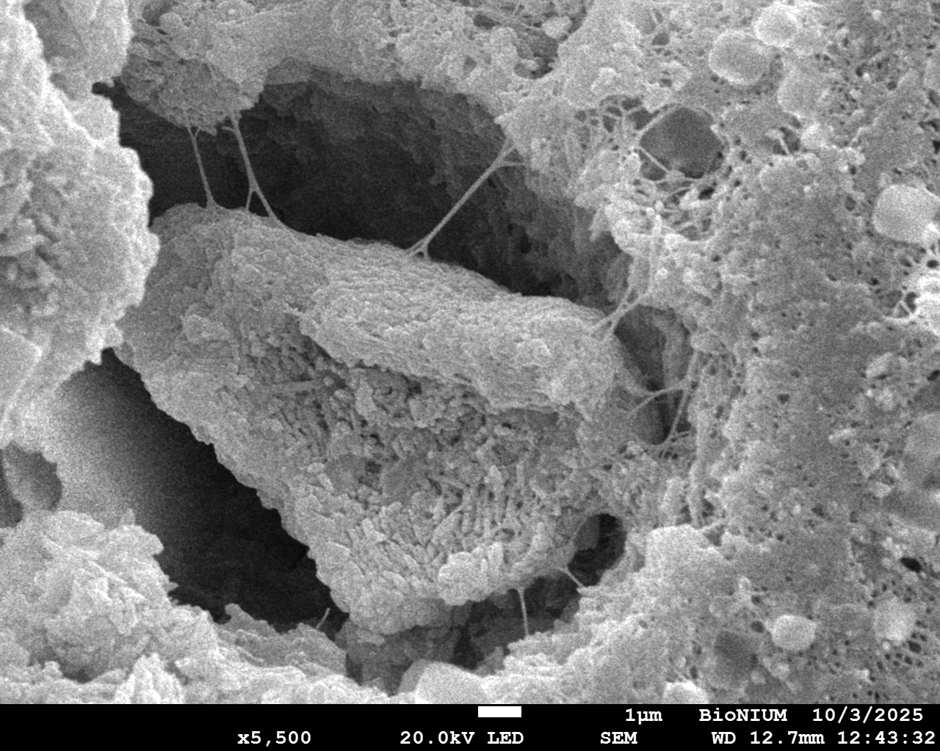
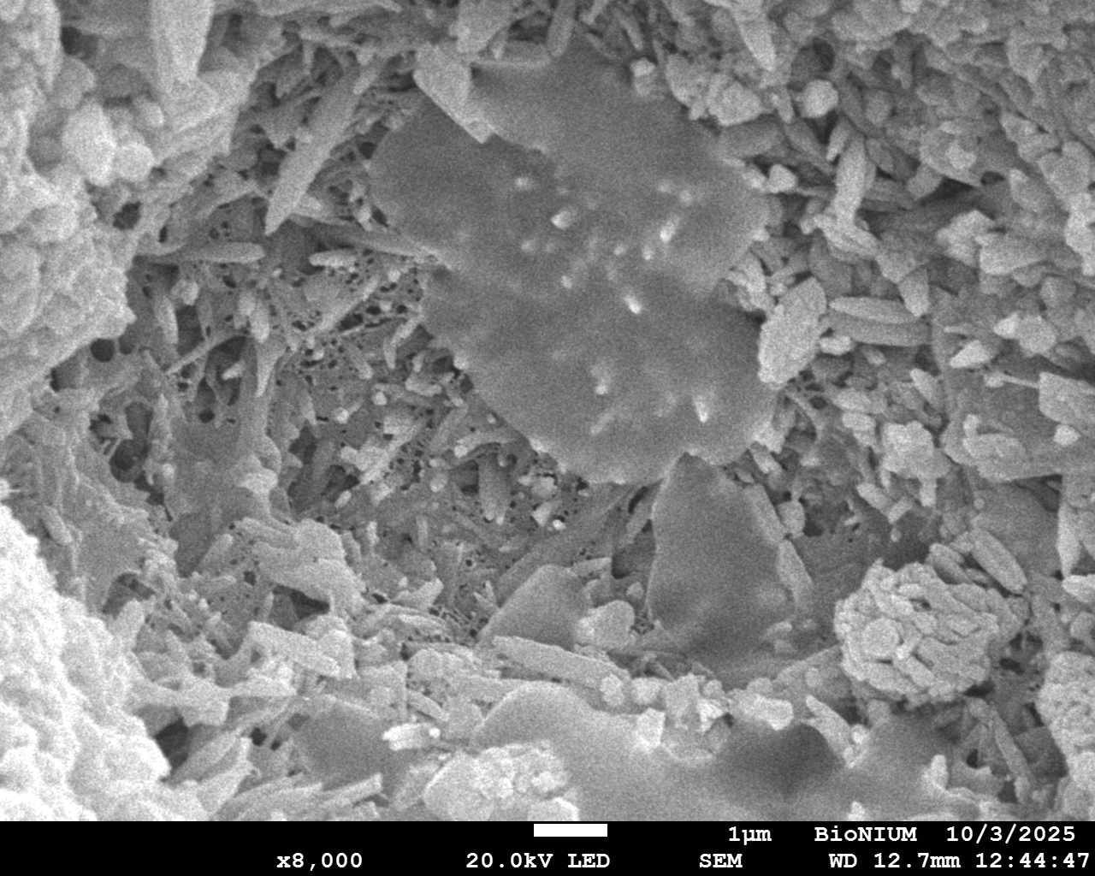
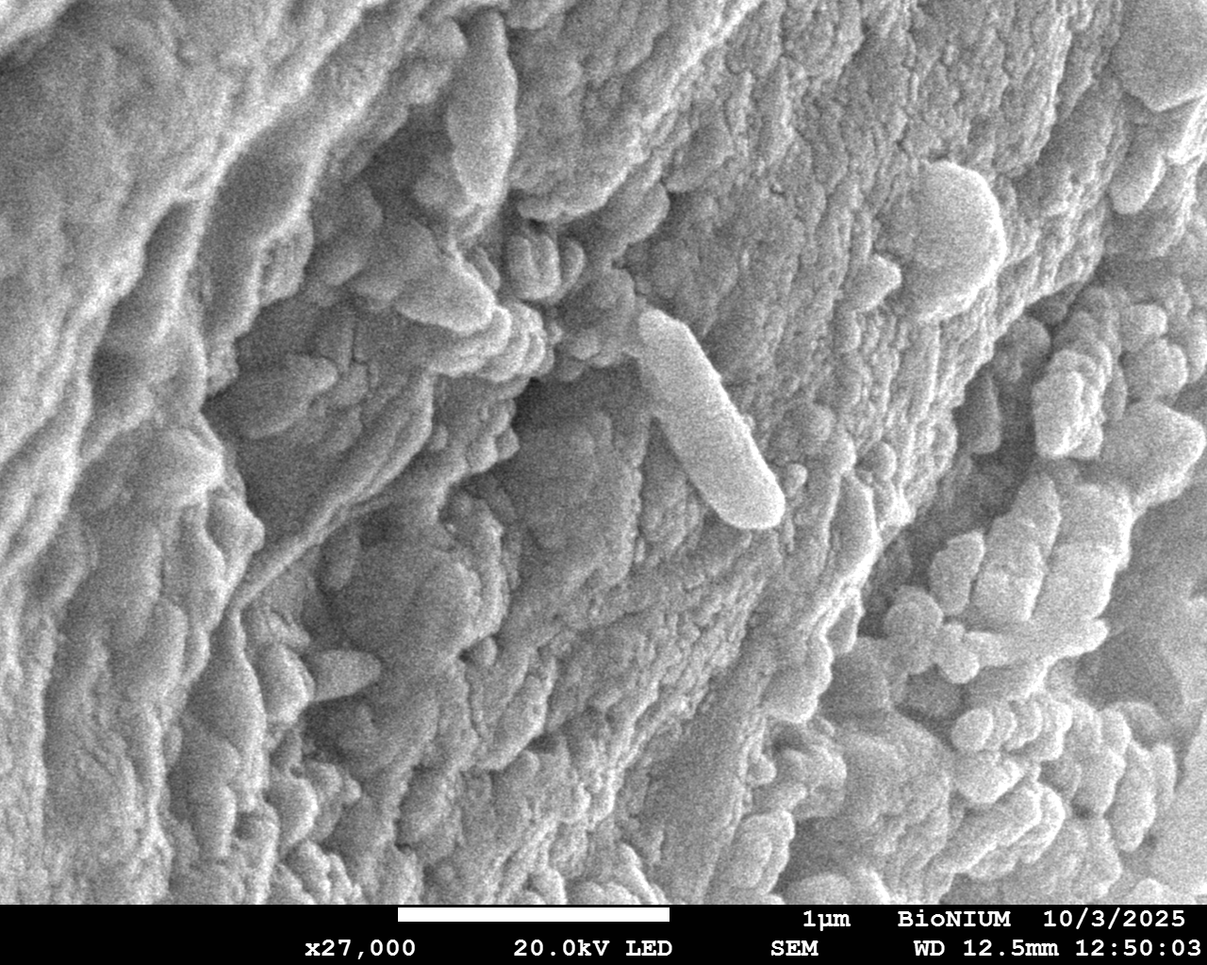
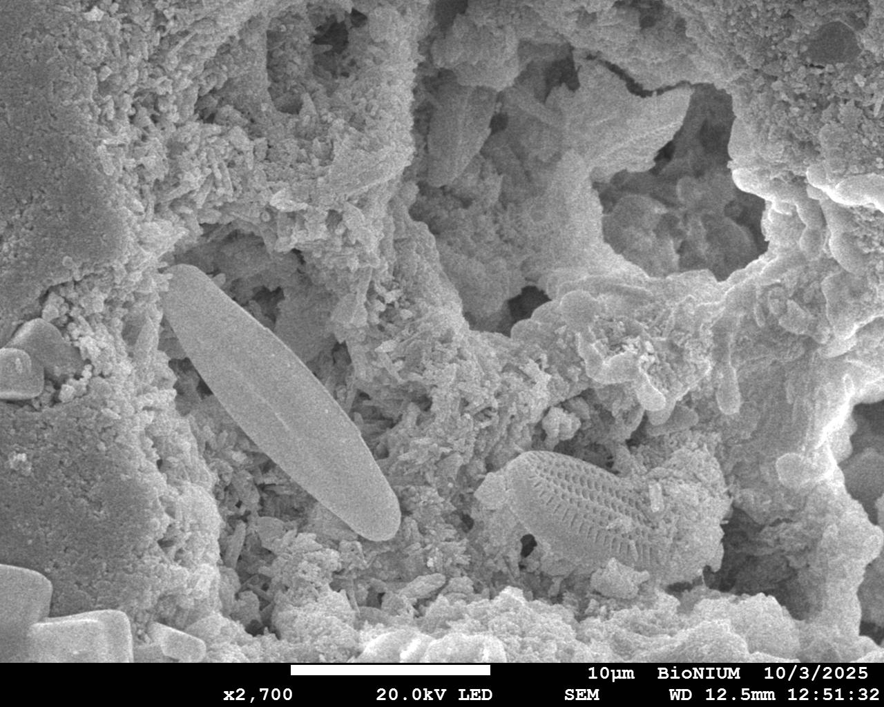
Time 0 untreated – with microbes
Eberli et al. 2025
EPS threads
EPS with nanograins
Diatoms
Rodshaped bacteria
Notes:
Time 0 -untreated

Slide 14
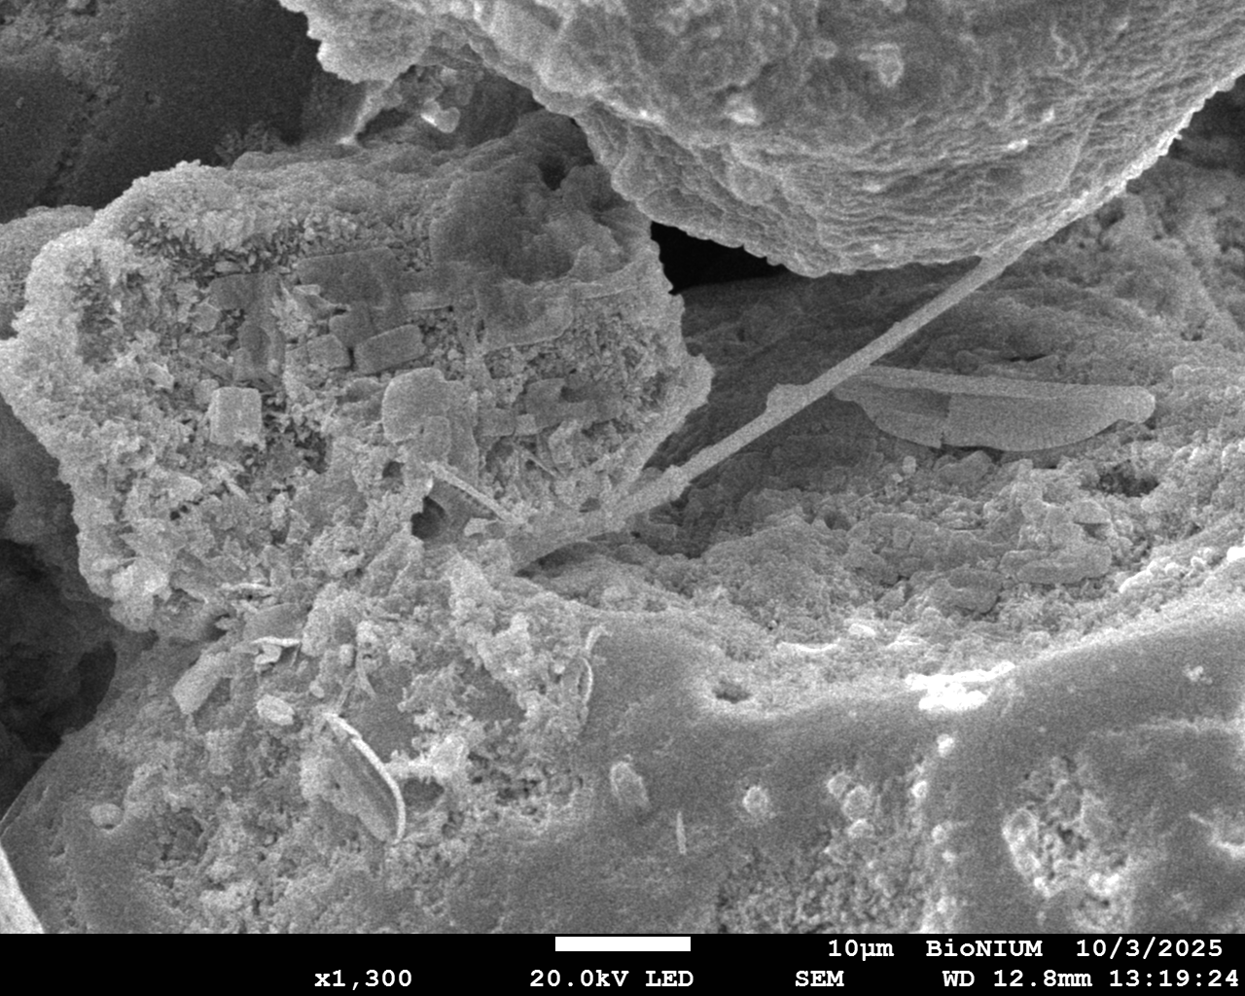
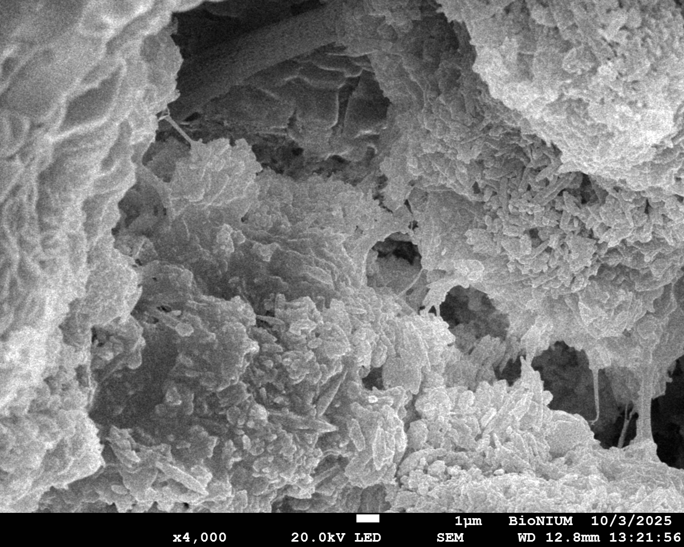
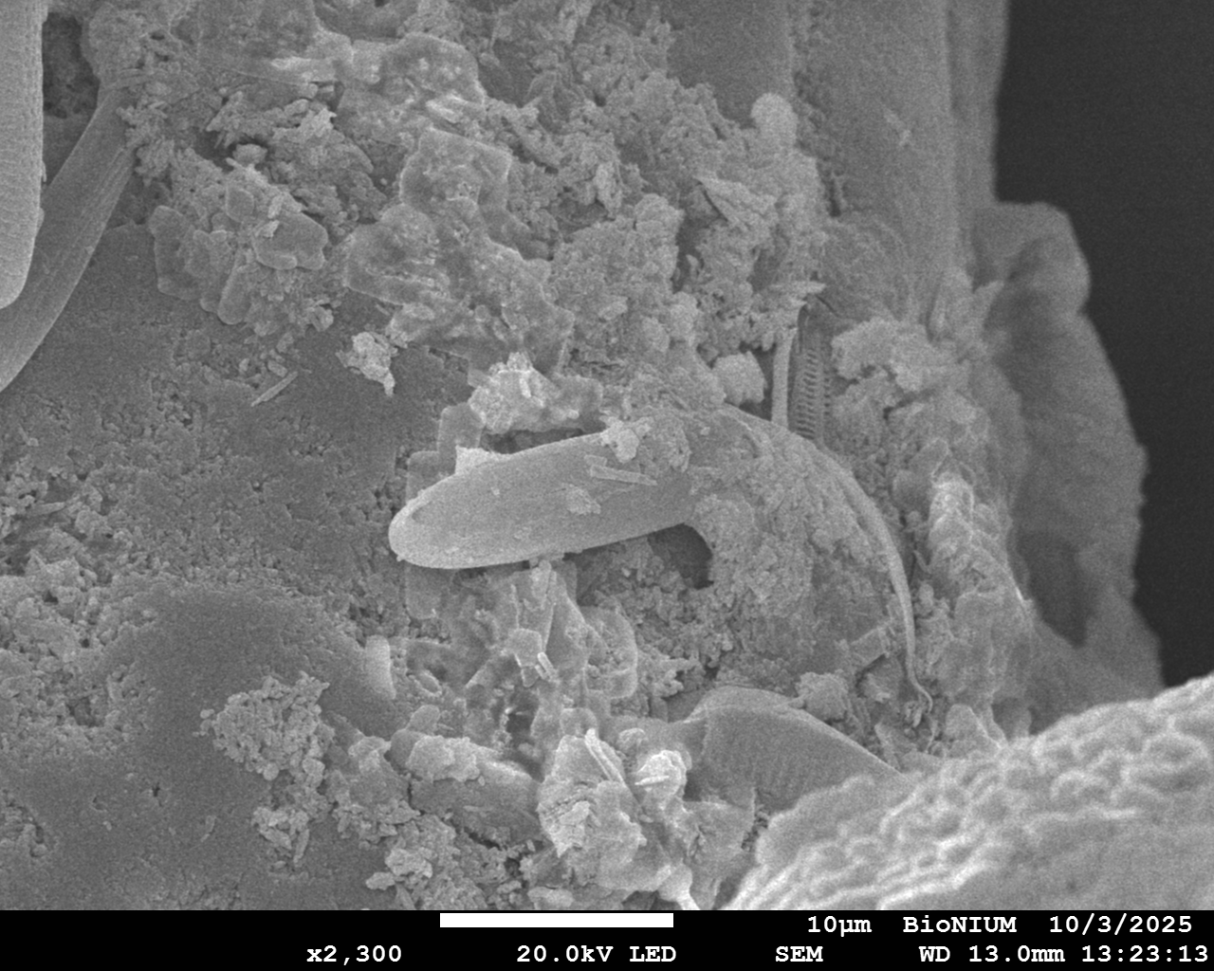
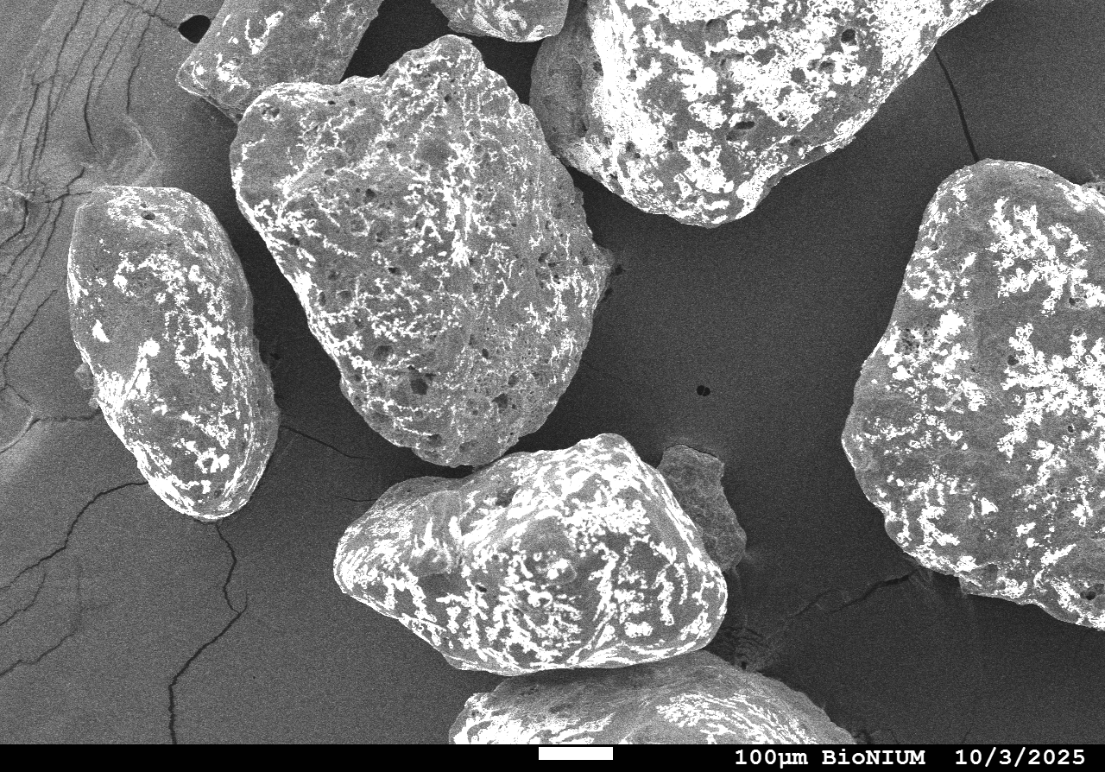
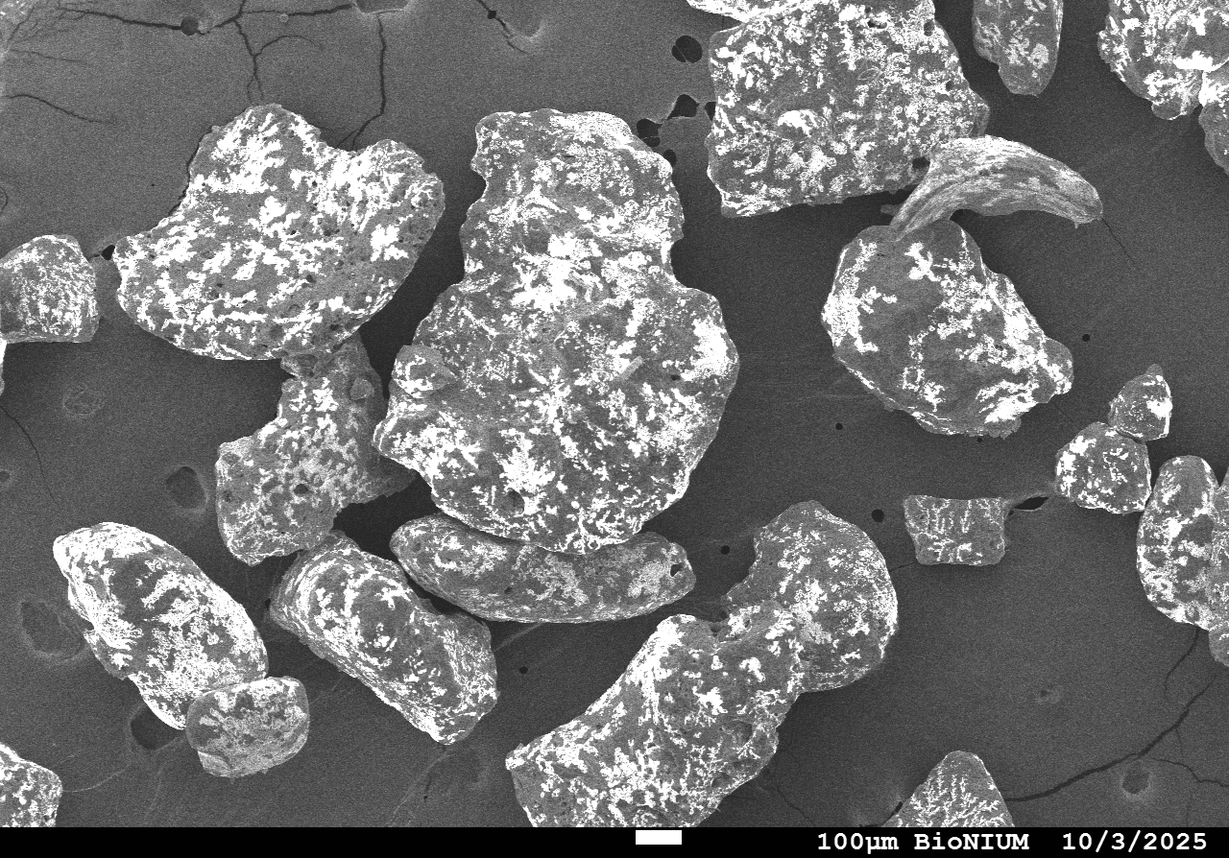
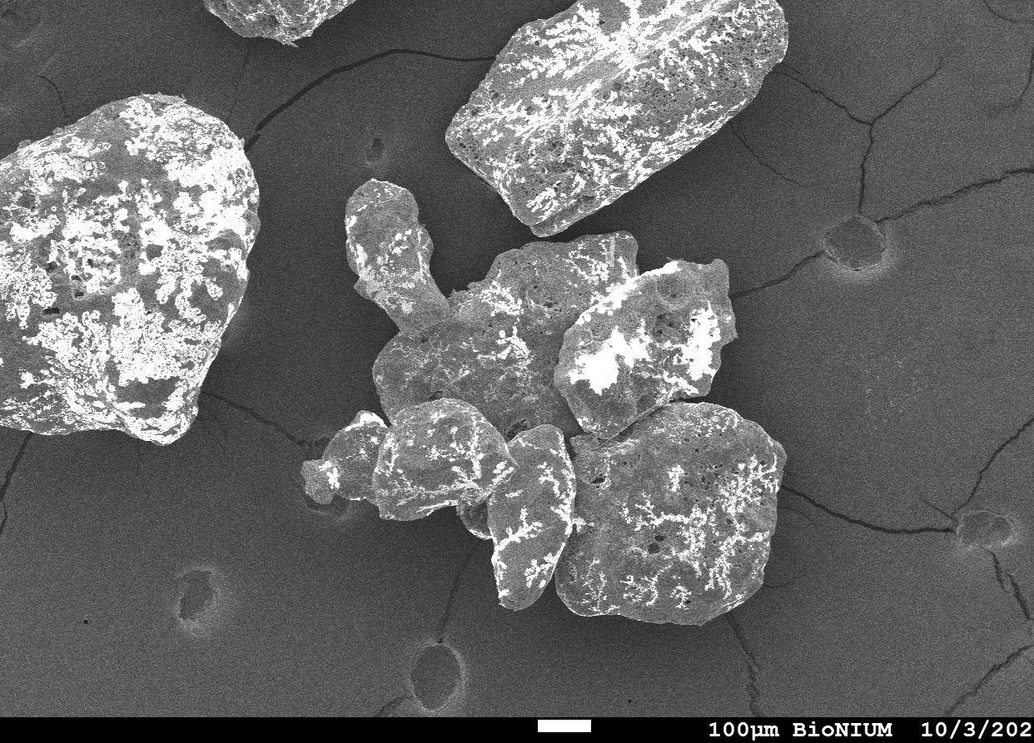
90 days untreated – with microbes
Eberli et al. 2025
Calc. filament
Notes:
90 days - untreated

Slide 15
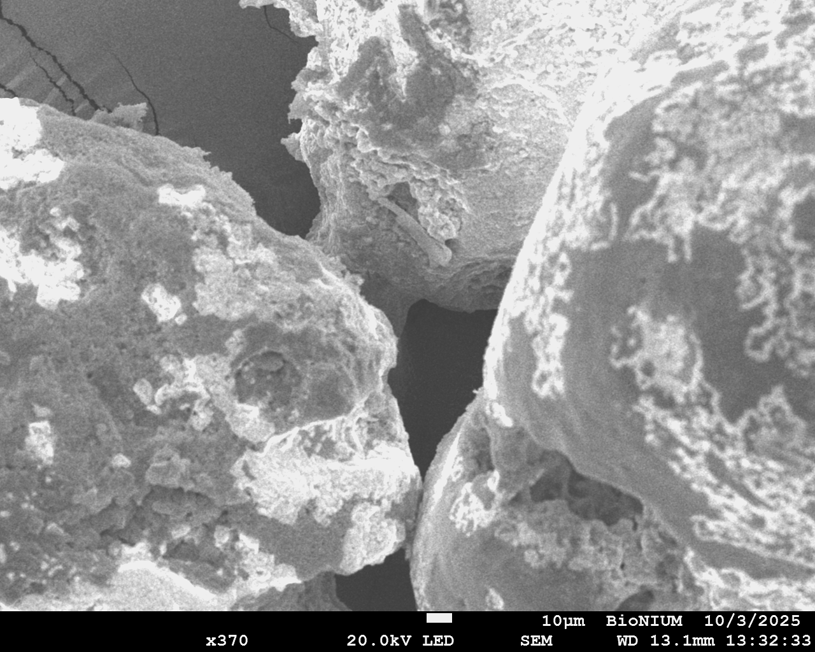
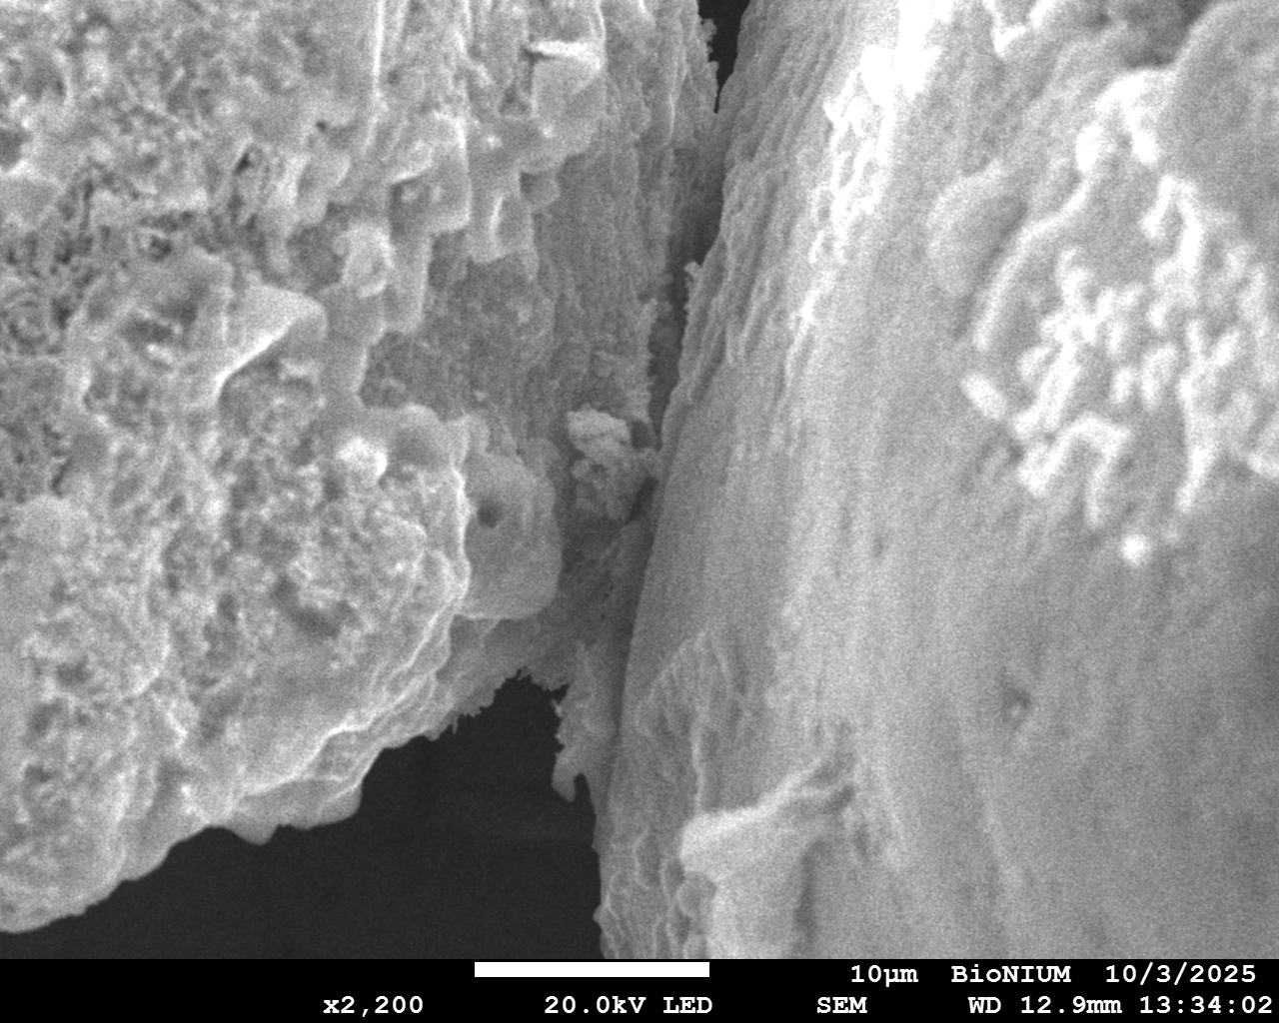
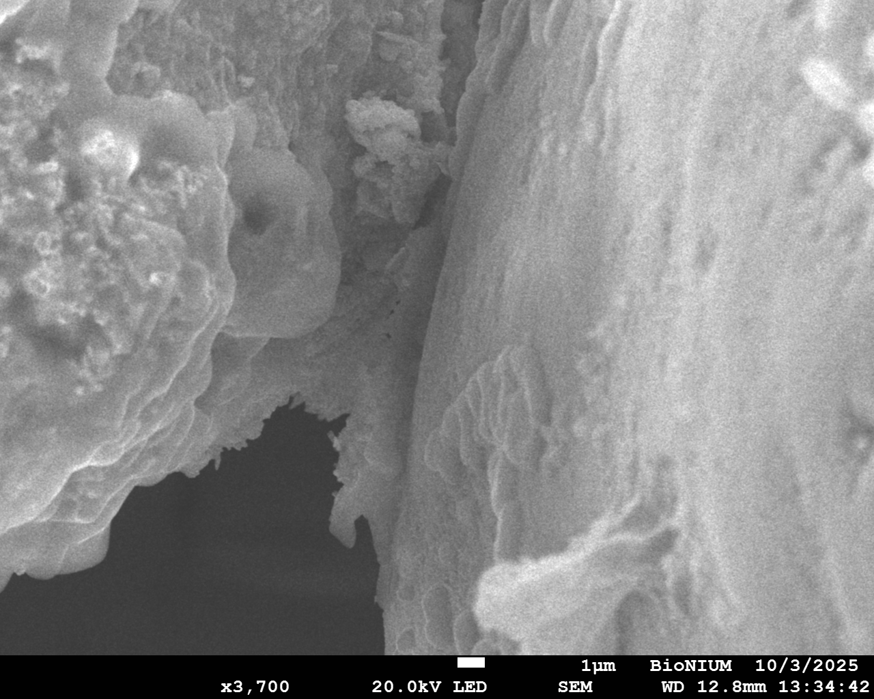



90 days untreated – with microbes
Eberli et al. 2025
Notes:
90 days - untreated

Slide 16




Lithified seafloor of skeletal sediment
Eberli et al. 2025
Rudstone
Pavement

Slide 17

Micritic Meniscus Cement in Coquinas
Eberli et al. 2025
In vitro bridging cement
From Diaz and Eberli 2021

Slide 18

Difference – ooids vs skeletal grains
Eberli et al. 2025
Small amount of micritic bridging cements in the skeletal sand after 90 days,
in contrast to the extensive microbial activity and cements at ooid grain contacts after only 30 days.
How do we explain this?

Slide 19




Evidence of vectors for ooid formation
Paradis 2019
Eberli et al. 2025
EPS
200 µm
Brine shrimp (Artemia) fecal pellets (left) Great Salt Lake ooid with pellet nucleus (right).

Slide 20



Ooids versus Skeletal grain contacts
30 days
Eberli et al. 2025
EPS
90 days
In ooids, along the entire grain-grain contact micritic cement is forming beneath decaying EPS, indicating that microbial community within the ooid is contributing to the cementation process.
Skeletal sands have the microbial community only on the surface

Slide 21



Lithified seafloor of ooid sand
Eberli et al. 2025
Hardgrounds Tongue of the Ocean : Cemented seafloor of ooid grainstones in the tidal bar belt.

Slide 22





Micritic Cement in ooid hardground
Eberli et al. 2025
MB44-1
Micritic meniscus
cement
100B-3
Compared to the skeletal pavement, the ooid hardgrounds have an abundance of micritic cements (meniscus and bridges)
Meniscus cement
Micritic contact cement
Fibrous aragonite
500 μm

Slide 23

Other factors for cementation
Eberli et al. 2025
Beside the microbial load, porosity, organic content and shape heterogeneity will be factors for the rate and location of cements.

Slide 24
Conclusions
Eberli et al. 2025
Early marine cementation in skeletal sands is at a slower rate and lesser amount than ooid sands.
This difference can be explained by the different microbial load of ooids versus skeletal grains.
Indigenous microbial community within ooids contribute to the early micritic cement, while skeletal sands rely solely on surface microbial community.
In addition, differences in porosity, organic content and heterogeneity of the grains might add to the slower cementation rate.

Slide 25

Ooid cementation
Oolites from the Broadford Formation on the Isle of Skye, Scotland
Oolites from the Cretaceous in the Campos Basin, Brazil

Slide 26




90 days treated
Eberli et al. 2025
Organic material = contamination of the sample
Notes:
90 days- - treated

