Slide 1
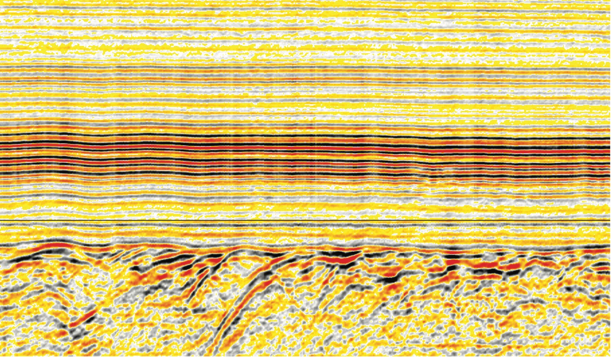

What happened to sequence stratigraphy?
Gregor P. Eberli and Mark Grasmueck

Slide 2

Key Questions
Eberli & Grasmueck 2025
Is Sequence stratigraphy loosing on importance?
If so, what are the reasons?
Can it come back by being incorporated into advanced interpretation packages such as Paleoscan?

Slide 3
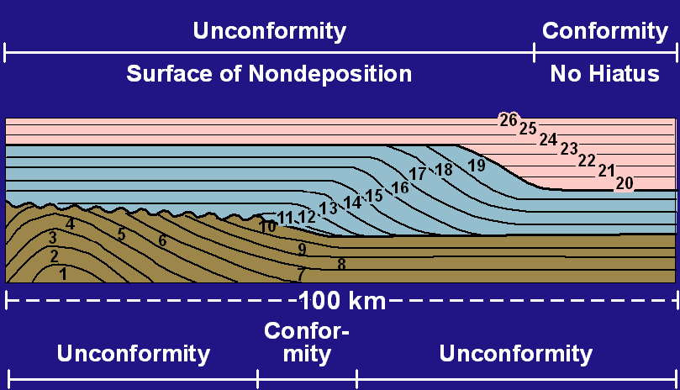
The beginning of sequence stratigraphy
Eberli & Grasmueck 2025
Vail et al (1977)
“stratigraphic unit composed of a relatively conformable succession of genetically related strata bounded at its top and base by unconformities or correlative conformities”

Slide 4
Assumptions in Sequence Stratigraphy
Eberli & Grasmueck 2025
Chronostratigraphic significance of seismic reflections
  Seismic Reflection are timelines
  Sequences are chronostratigraphic units
Eustatic signal recorded in sedimentary strata
Sedimentary response to relative sea level change is predictable
  Facies distribution is related to sea level

Slide 5
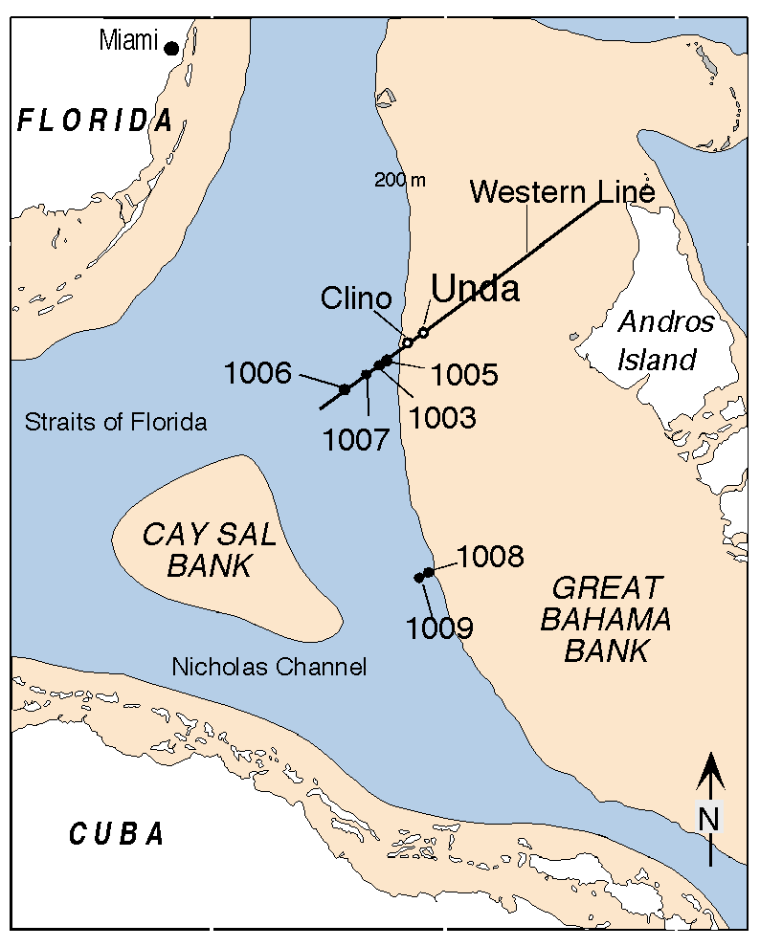
Testing Assumptions
The Bahamas Transect: Test of sequence stratigraphic concept in carbonates
Eberli et al. 1998
Are the prograding sequences sea level controlled?
What is the timing of the seismic sequence boundaries? Are seismic reflections time line?

Slide 6
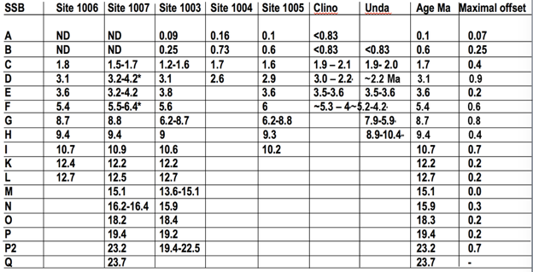
Seismic reflections are timelines
Eberli & Grasmueck 2025
Anselmetti et al. 2000
Biostratigraphic dating of sequence boundaries along the Bahamas Transect confirmed the chronostratigraphic significance of seismic reflections marking sequence boundaries.

Slide 7
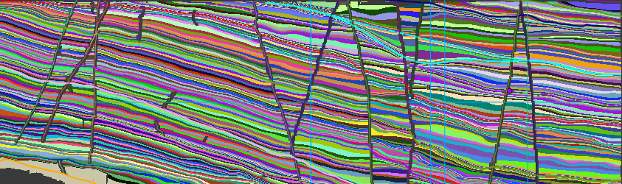
Applying the concept of reflections as timelines
Eberli & Grasmueck 2025
Once the assumption that seismic reflections are timelines was accepted it was implemented into the interpretation packages starting with autotrack and more recently with relative geologic time models in Paleoscan.
Example of Relative Geological Time (RGT) Model in Paleoscan™.

Slide 8
Strength of Sequence Stratigraphy
Eberli & Grasmueck 2025
Correlation of time-equivalent sedimentary units
Prediction of age
Prediction of facies within the geometries displayed by seismic data
Prediction of continuity of sedimentary units

Slide 9
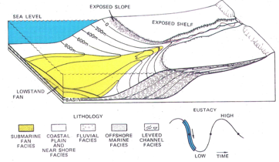
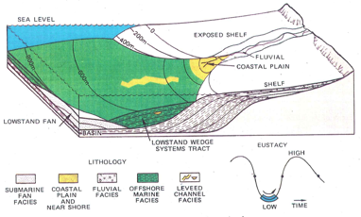
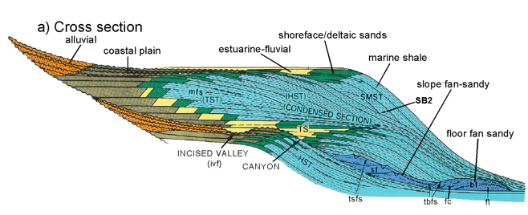
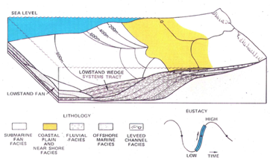
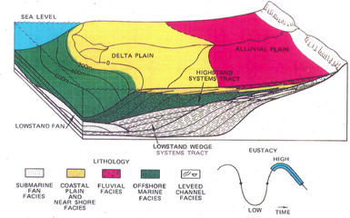
Prediction of Facies with Sequence Stratigraphy
Eberli & Grasmueck 2025
Prediction of facies using sequence stratigraphy stems from understanding the evolution of the sedimentary system during the changes of sea level.
Sea Level Fall
Sea Level Low
Sea Level Rise
Sea Level High
Posamentier and Vail (1988)

Slide 10
Cause of Sequence Boundaries
Eberli & Grasmueck 2025
Posamentier and Vail (1988)
“…It is composed of a succession of systems tracts and it is interpreted to be deposited between eustatic fall inflection points”
Van Wagoner et al., 1988
“..a surface…along which there is evidence of subaerial exposure truncation (and in some cases correlative submarine erosion) or subaerial exposure”

Slide 11
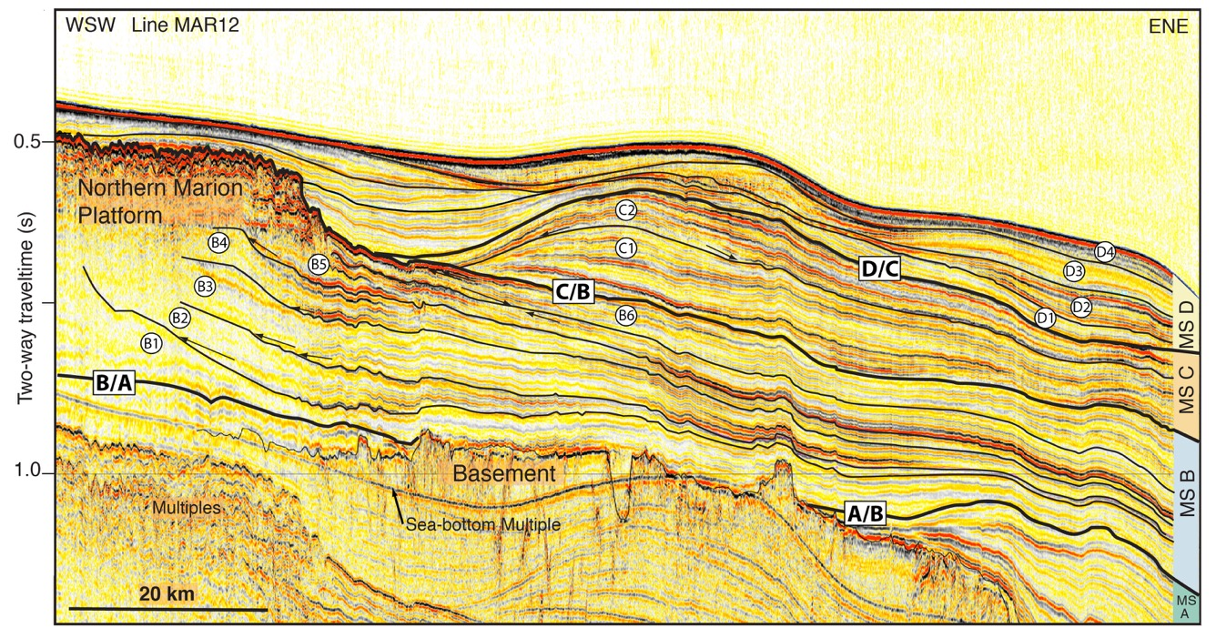
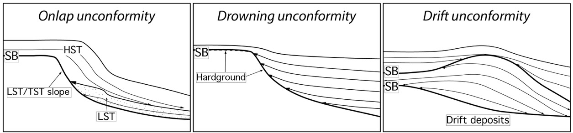
Variable Causes of Sequence Boundaries
Eberli & Grasmueck 2025

Slide 12

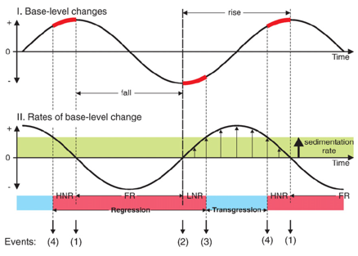
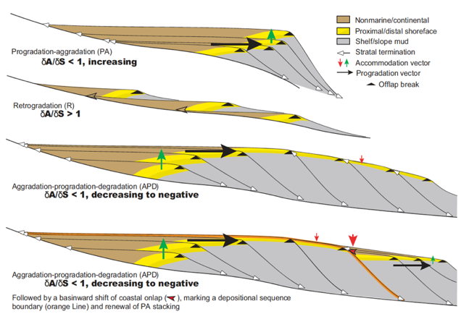
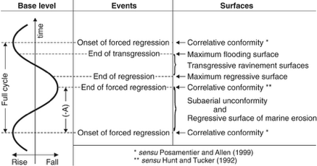
Headwinds against Sequence Stratigraphy
Eberli & Grasmueck 2025
Neal and Abreu (2009)
Catuneanu et al., Earth-Science Reviews 92 (2009)

Slide 13
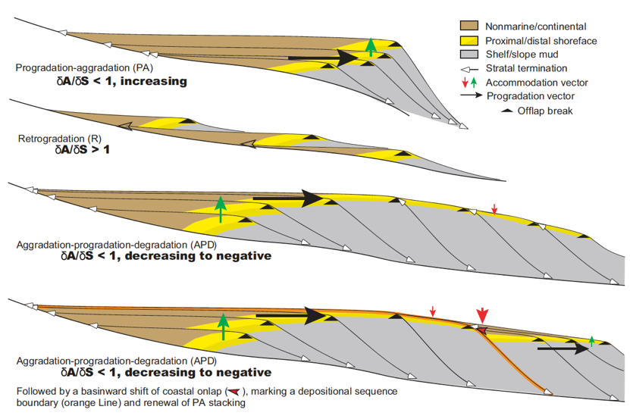
Accommodation succession method (Neal and Abreu,2009)
Eberli & Grasmueck 2025
“Stratal stacking patterns associated with changing rates of coastal accommodation creation (δA) and sediment fill (δS), which we refer to as accommodation succession.”
Following a sequence boundary, the stratigraphic motif is
Progradation to aggradation (PA), retrogradation (R),
aggradation to progradation to degradation (APD),
representing stratal geometries of lowstand, transgressive, and highstand systems tracts, respectively.”
LST
TST
HST

Slide 14
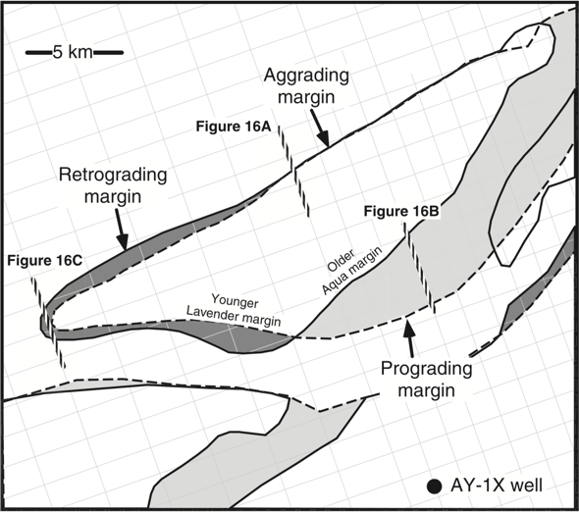
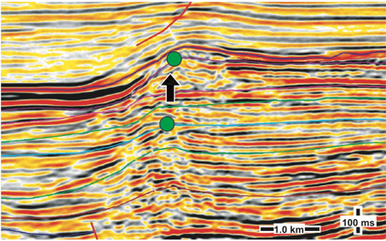
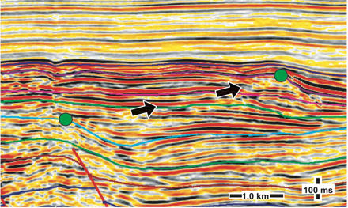
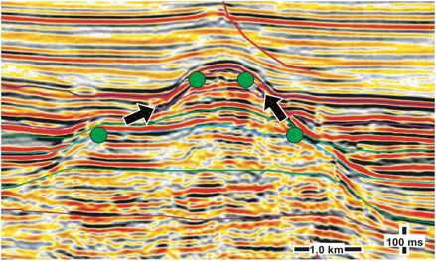
Coeval Aggradation, Progradation and Retrogradation
Eberli & Grasmueck 2025
Windward Side
Aggradation
Progradation
Leeward Side
NW part of Segitiga Platform
Bachtel et al. 2004
Retrogradation

Slide 15

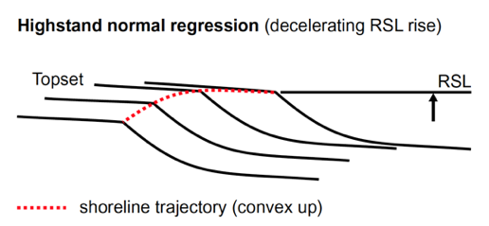
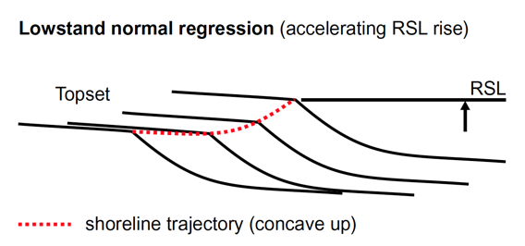
“Catuneanu” sequence stratigraphy method
Eberli & Grasmueck 2025
Catuneanu et al., Earth-Science Reviews 92 (2009) 1–33

Slide 16
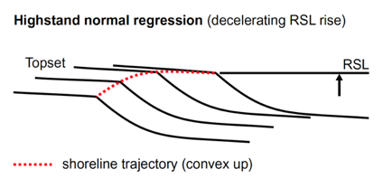
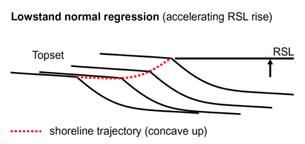
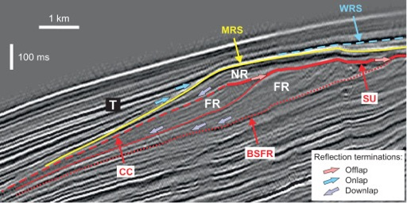
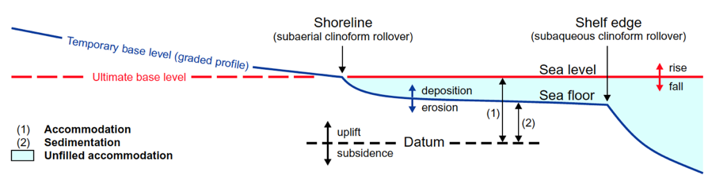
Assumption in “Catuneanu” Method
“At the basin scale, the trajectory of the shelf edge is the first-order shoreline trajectory,…”
This assumption has never been tested.

Slide 17
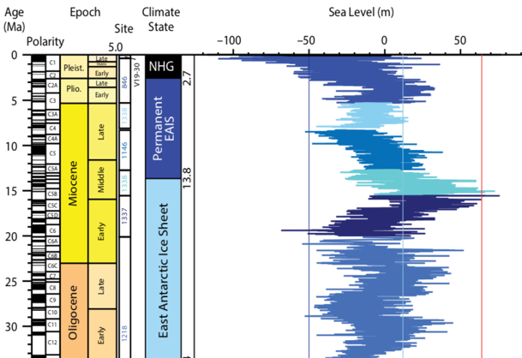
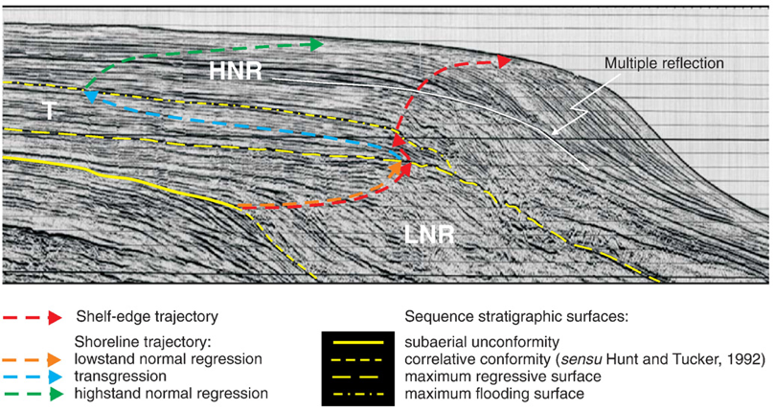
Example used in both publications
Eberli & Grasmueck 2025
Dip line Pelotas Basin: Burdigalian to recent = ~ 18 myrs of strata
There was no large-scale base level fluctuation in the last 18 myrs but sea level has fluctuated widely.
Where is the source of the sediment along this margin?

Slide 18
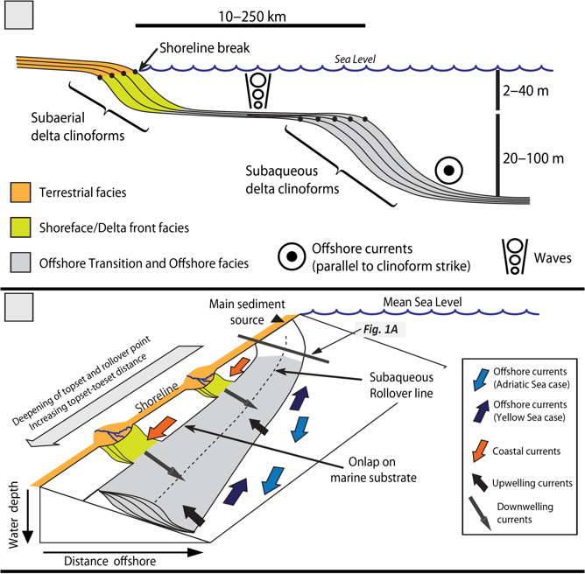
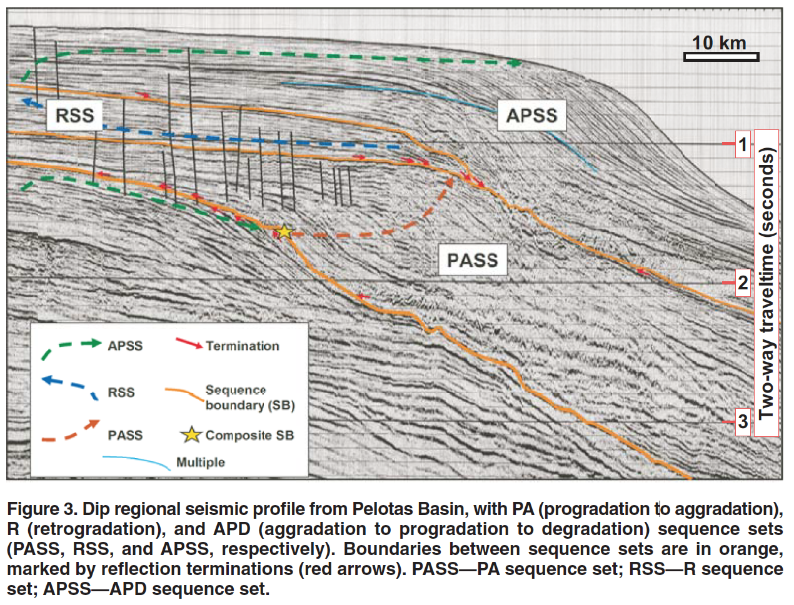
Shoreline versus shelf edge trajectory
Eberli et al., 2023
Pelotas Basin
400 ms = 300 m water depth
Patruno et al., 2015

Slide 19
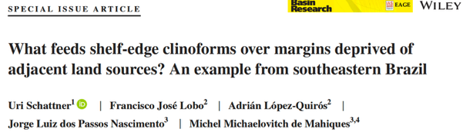
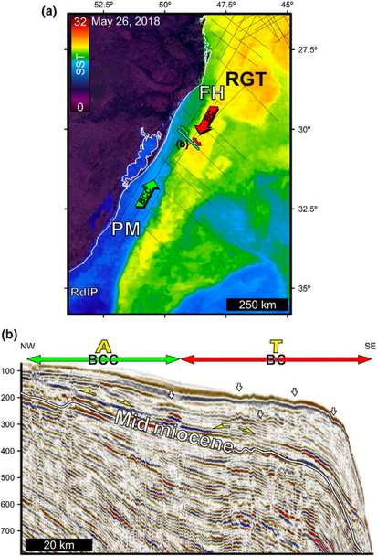
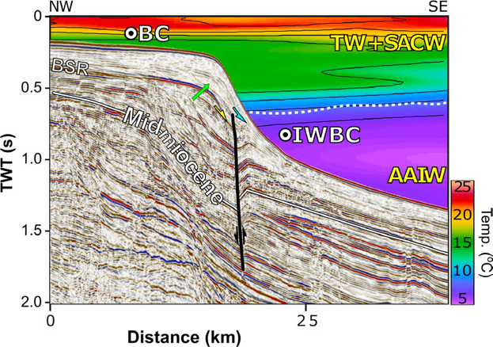
Current influence on sequence development
2019
Eberli & Grasmueck 2025
The continuous clinoform development … is attributed to the major influence on sediment transport patterns of several ocean bottom currents flowing along the margin, such as the Brazil Coastal Current, the Brazil Current and the Intermediate Water Brazil Current.
These currents erode, transport and distribute sediments across the shelf break and upper slope from distant sediment sources ….
Pelotas
margin
Seismic reflection profile crossing the Pelotas Margin.

Slide 20
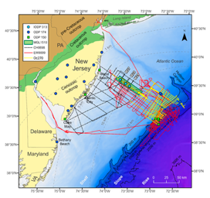
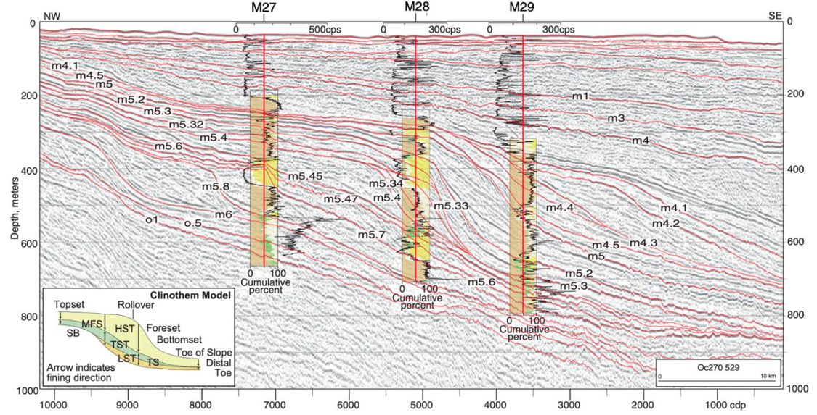
The New Jersey margin – it can get messy
Eberli & Grasmueck 2025
Miller et al. in press
MCS profile trending NW to SE across Expedition 313 Sites M27-M29 after Mountain et al. (2010).

Slide 21
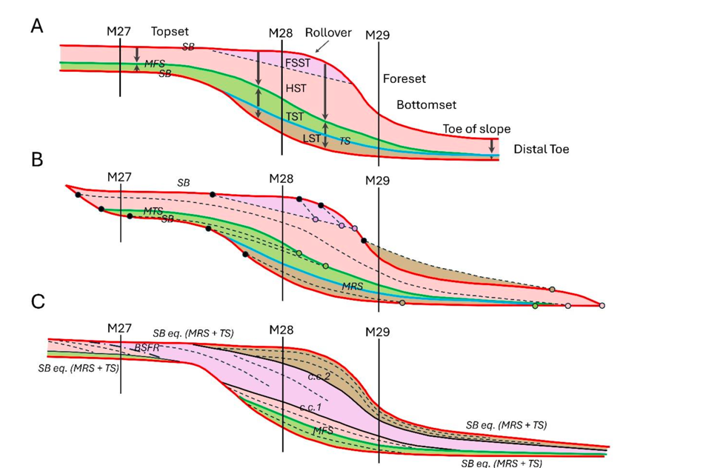
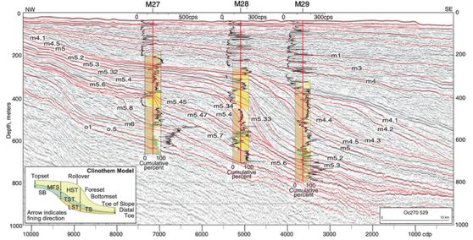
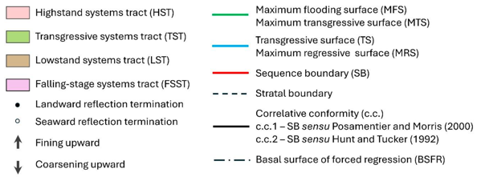
The mess we are in
Eberli & Grasmueck 2025
Miller et al. 2013
LST
HST
Proust et al. (2018)
using forced regression model of Catuneanu

Slide 22
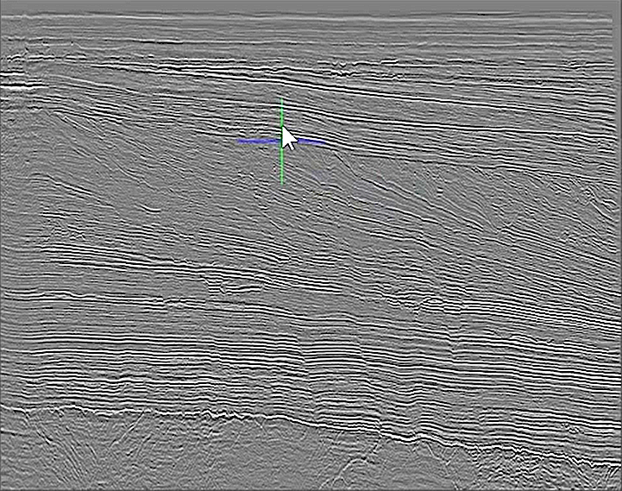
3D Seismic Data
Paleoscan™
Automated Sequence Stratigraphy ?

Slide 23
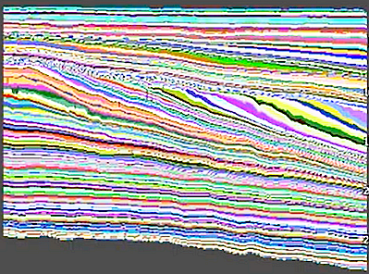
3D Seismic Data
3D RGT Model
Relative Geologic Time
Paleoscan™
Automated Sequence Stratigraphy ?

Slide 24
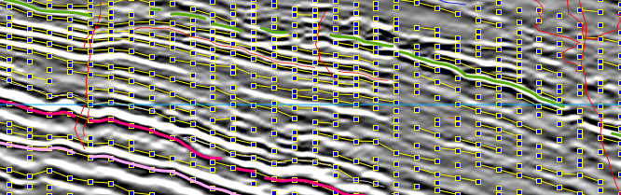
Node Connections
Paleoscan™
Automated Sequence Stratigraphy ?

Slide 25
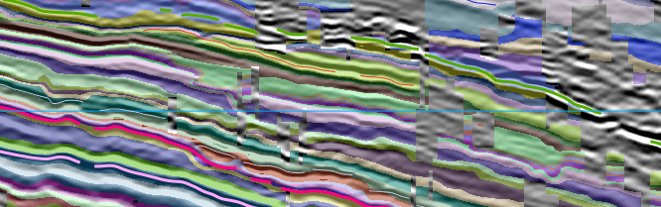
Auto Interpretation
Paleoscan™
Automated Sequence Stratigraphy ?

Slide 26
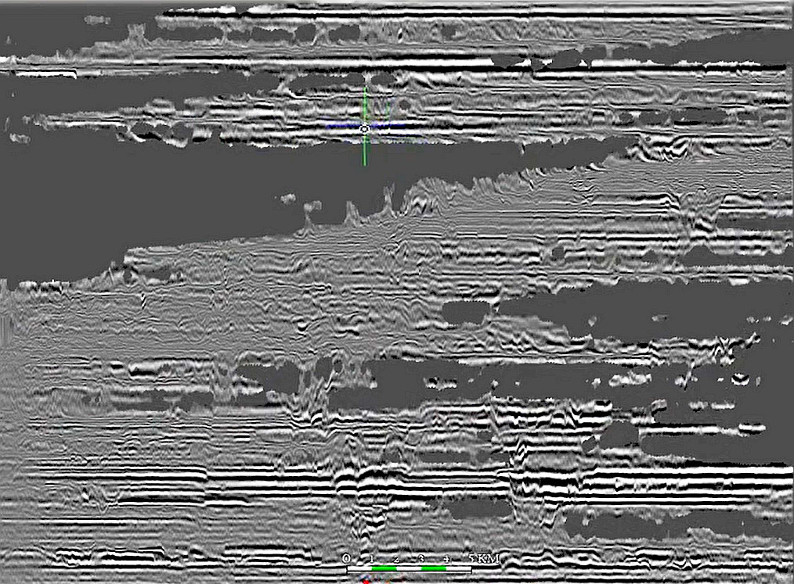
3D Seismic Data
3D RGT Model
Relative Geologic Time
Wheeler Diagram
Paleoscan™
Automated Sequence Stratigraphy ?

Slide 27
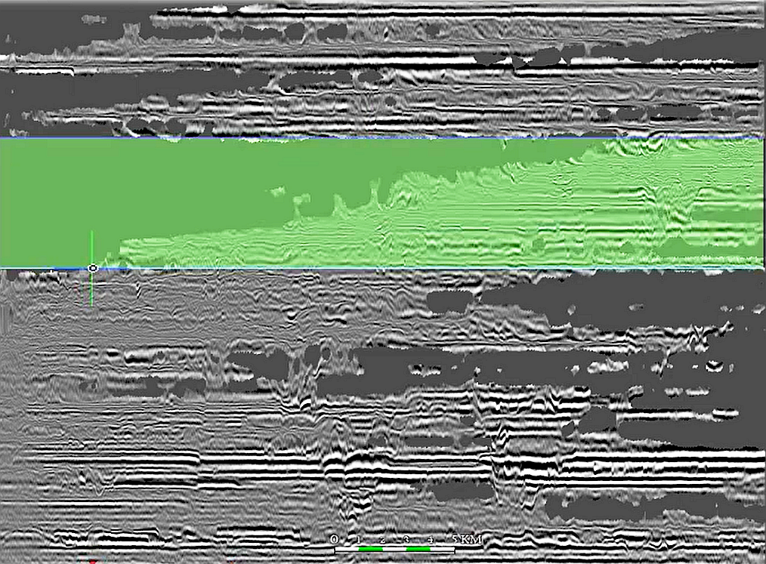
3D Seismic Data
3D RGT Model
Relative Geologic Time
Wheeler Diagram
Paleoscan™
Automated Sequence Stratigraphy ?

Slide 28
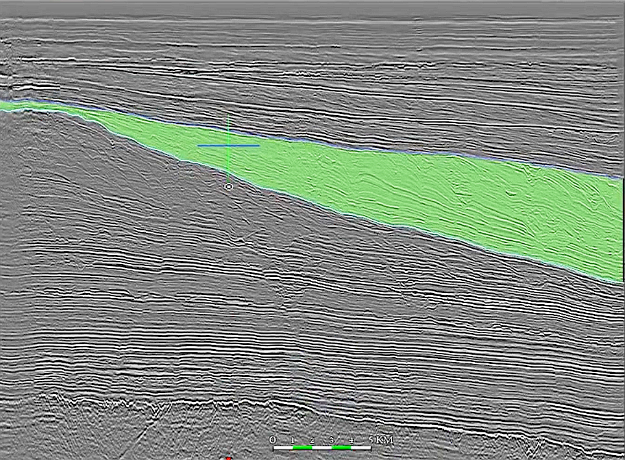
3D Seismic Data
3D RGT Model
Relative Geologic Time
Wheeler Diagram
Paleoscan™
Automated Sequence Stratigraphy ?

Slide 29
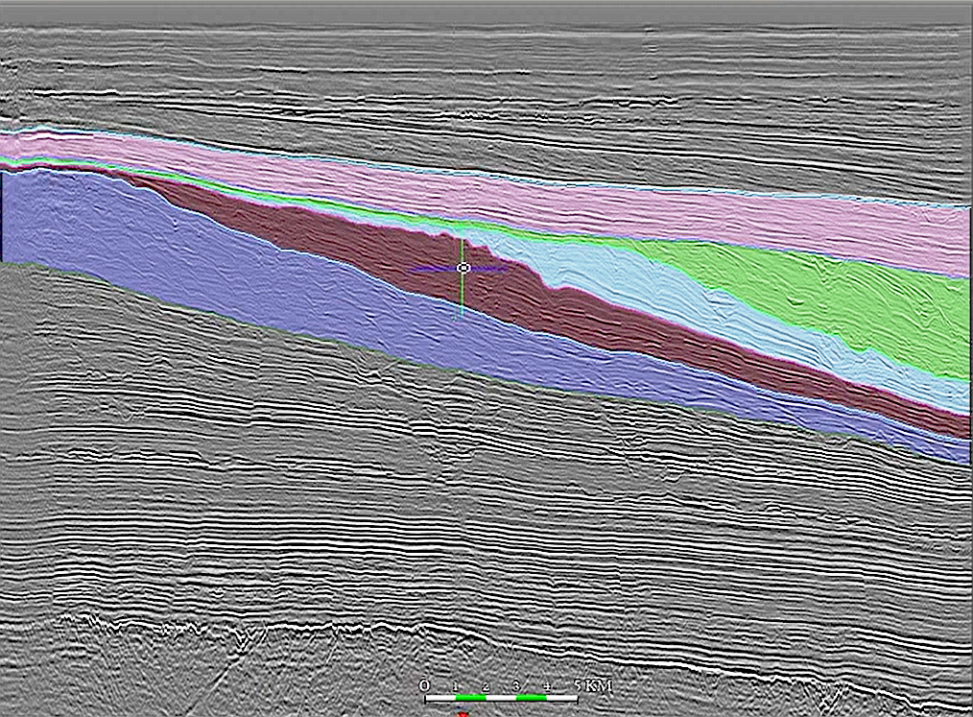
3D Seismic Data
3D RGT Model
Relative Geologic Time
Wheeler Diagram
Paleoscan™
Automated Sequence Stratigraphy ?
Sequences

Slide 30
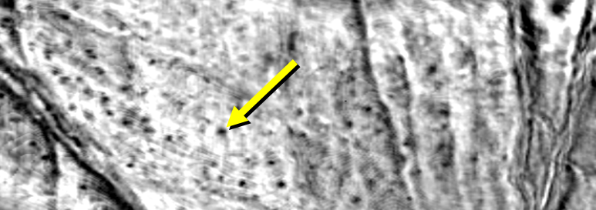
3D Seismic Data
3D RGT Model
Relative Geologic Time
Wheeler Diagram
added BONUS Stratal Slices
Sequences

Slide 31
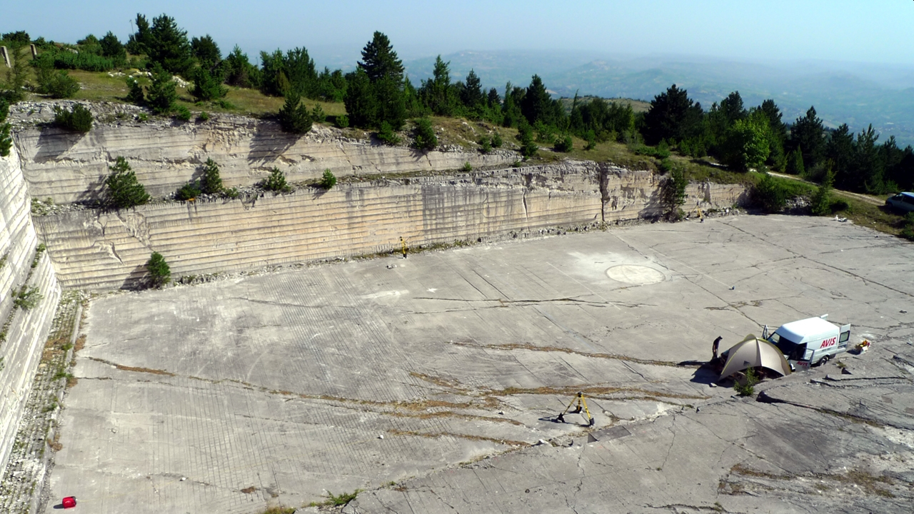
Madonna della Mazza Quarry, Maiella Mountains (Italy)
Carbonate
Contourite Delta Drift
Field data Example
N
Grasmueck and Eberli CSL Miami 2024

Slide 32
Madonna della Mazza Quarry, Maiella Mountains (Italy)
Full-Resolution 3D GPR Survey
200 MHz
Grid Spacing 0.1 x 0.05 m
Full-Resolution 3D GPR Survey
200 MHz
Grid Spacing 0.1 x 0.05 m
N
Eberli and Grasmueck CSL Miami 2025

Slide 33
Factors influencing the RGT Model
Paleoscan Parameters
Dataquality
Colorbar Choice
Fault Discontinuities
Reflector Continuity , Unconformities
Dipline / Strikeline
>> to get to a high quality RGT model many choices have to be made !
Goal: Sequence Boundaries & Bodies
Eberli and Grasmueck CSL Miami 2025

Slide 34
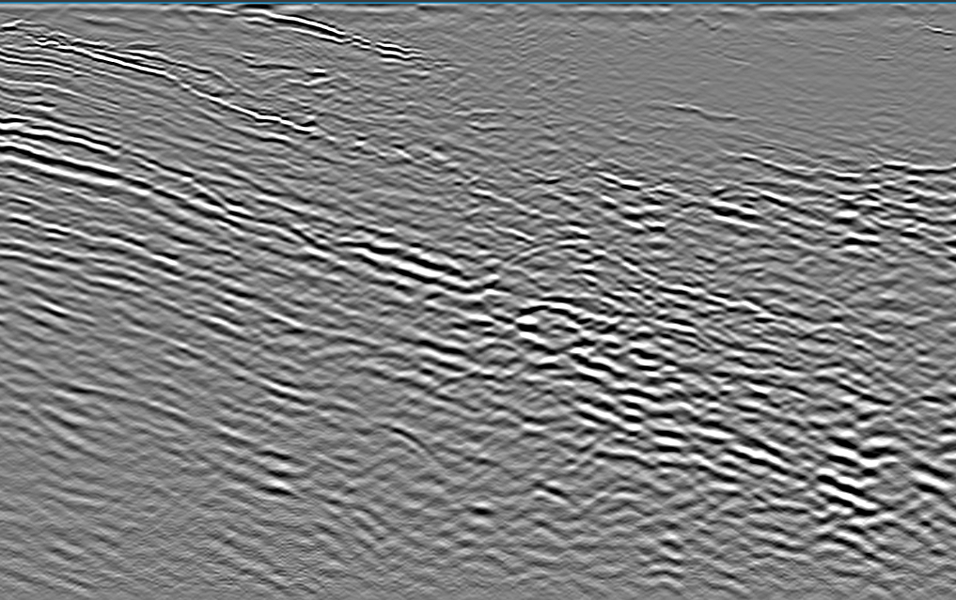
Paleoscan Parameters
3D GPR XL 297
Eberli and Grasmueck CSL Miami 2025

Slide 35
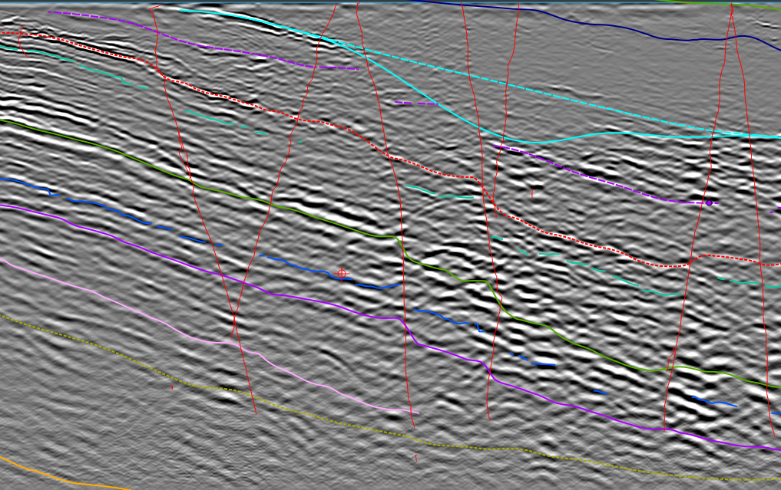
Paleoscan Parameters
Fault and Horizon Constraints
Eberli and Grasmueck CSL Miami 2025

Slide 36

Paleoscan Parameters
Connectivity Grid
Eberli and Grasmueck CSL Miami 2025

Slide 37

Paleoscan Parameters
Connectivity Grid
Eberli and Grasmueck CSL Miami 2025

Slide 38

Paleoscan Parameters
Default Smoothing and Interpolation
Eberli and Grasmueck CSL Miami 2025

Slide 39

Paleoscan Parameters
More Smoothing and Interpolation
Eberli and Grasmueck CSL Miami 2025

Slide 40

Colorbar Choice
Default RGT Colorbar
Younger
Default Smoth & Interpol
More Smoth & Interpol
Older
Eberli and Grasmueck CSL Miami 2025

Slide 41



Colorbar Choice
Simple Colorbar
Younger
Default Smoth & Interpol
More Smoth & Interpol
Older
Eberli and Grasmueck CSL Miami 2025

Slide 42

Fault Discontinuities
Automatic Fault Extraction
Eberli and Grasmueck CSL Miami 2025

Slide 43

Fault Discontinuities
Manual Picking & small AFE Faults
Eberli and Grasmueck CSL Miami 2025

Slide 44

Dipline / Strikeline
Strikeline
Dipline
Timeslice
Eberli and Grasmueck CSL Miami 2025

Slide 45


Strikeline
Reflector Continuity & Unconformities
Dipline
Eberli and Grasmueck CSL Miami 2025

Slide 46

Added BONUS
Stratal Slices
Small Pot-holes
about 200 over an Area of 400m²
5m
N
N
show sedimentary Structures much better than Timeslices and are quick and easy to generate
Eberli and Grasmueck CSL Miami 2025

Slide 47
3D Seismic Data
3D RGT Model
Relative Geologic Time
Wheeler Diagram
Paleoscan™
Automated Sequence Stratigraphy ?
Sequences
Eberli and Grasmueck CSL Miami 2025

Slide 48
3D Seismic Data
3D RGT Model
Relative Geologic Time
Wheeler Diagram
Paleoscan™
Enhanced Sequence Stratigraphy
Sequences
Eberli and Grasmueck CSL Miami 2025

Slide 49
Conclusions & Implications
Eberli & Grasmueck 2025
Sequence Stratigraphy is not used much anymore!
…..many reasons
If it is used, often with the wrong method
…..Loss of Prediction Capability
With the new RGT Tools and Models we can take Sequence Stratigraphy to a new Level
…..needs Skill and Time

Slide 53
The mess we are in
Eberli & Grasmueck 2025
Miller et al. 2013
Aali et al. (2021)
Proust et al. (2018) using forced regression model of Catuneanu

